Slide 1


JUABOSO DISTRICT ASSEMBLY
2023-2026 COMPOSITE BUDGET
PRESENTED BY HON. GODFRED KWABENA AGYEI
DISTRICT CHIEF EXECUTIVE

Slide 2
Outline of the Presentation
Introduction
Strategic Overview of the MMDA
Financial Performance – Revenue
Expenditure
Key Achievements for 2022
2022 Budget Programme Performance
Outlook for 2023-2026

Slide 3
INTRODUCTION
Juaboso District Assembly was established by Legislative Instrument LI (2020) in 2012. The District Capital is Sefwi Juboso with 16 Electoral Areas and 7 government Appointees. The District Shares Boundary with Bia West to the north, Asunafo South and sefwi wiawso municipal to the East, Bodi district to the South, La cote D’ivoire and Suaman to the West.
VISION STATEMENT
“To be among the first class Districts in the Country”
MISSION STATEMENT
“Juaboso District Assembly (JDA) exists to raise the living standards of the people through formulation and implementation of policies in partnership with local development stakeholders to improve access to basic services to create opportunities for wealth creation”.
CORE FUNCTIONS
Exercise political and administrative authority in the District.
Promote local economic development
Provide guidance, give direction to and supervise other administrative authorities in the district as may be prescribed by law.
Exercise deliberative, legislative and executive functions

Slide 4
POPULATION
According to the result for 2021 population and housing census, the population of the District is 88,814 with a growth rate of 2.5%. The current population of the district stands at 91,034 males representing 52.4% and females 47.6% of the total population.
ECONOMY OF THE DISTRICT
Agriculture is the main economic activity in the District. It employs about 76.2%
5.7% are in craft and related trades occupations.
9.6% are in other occupations.
8.5 percent are in service and sales occupations
ROADS
There are about 241.5 kms of engineered roads in the District.
About 78.5 kms of this road are tarred and link Juaboso to major towns and other District capitals, the rest are feeder roads that bisect to other communities within the District.
EDUCATION:
Juaboso District has Nine (9) educational circuits.
290 Schools (109 KGs, 110 Primary Sch. and 67 JHS)
One (1) public and one (1)private Senior High Schools.
Gross Enrolment rate stands at 158.4% with 154.7% for males and 162.2% for females
Gender Parity Index (GPI) on GER stands at 1.05%

Slide 5
INTRODUCTION
HEALTH:
One (1) Government Hospital, One (1) Private Hospital, Two (2) Health Centre, Eight (8) Maternity homes
Thirty six (36 ) CHPS compounds.
The Doctor patient ratio stands at 1:19,881
SANITATION:
About 60.1% of households dispose their solid waste at public dumps (open space) and 12% dump indiscriminately. 10% of the population use pit latrine.
The Assembly gave priority to the construction of household toilets with the provision of digne-loo of 643 within 20 communities.
TOURISM:
The district has a number of tourist sites.
Eg Big Rock (NyoboePiri), Bodan rock and Adanbuma (box rock), Krokosue Forest Reserve, Boinzan waterfalls . However, these sites remains undeveloped.

Slide 6
KEY CHALLENGES/ISSUES
1. | Deplorable nature of Feeder roads.
2. | Inadequate Potable water facilities.
3. | Inadequate Market facilities.
4. | Inadequate Educational and Health infrastructure.
5. | Limited Agricultural Production and Productivity.
6. | Poor Sanitation and inadequate Storm Drains

Slide 7
ADOPTED POLICY OBJECTIVES
FOCUS AREA | ADOPTED POLICY OBJECTIVES
LOCAL GOVERNMENCE AND DECENTRALIZATION | Deepen political, financial and administrative decentralization
PUBLIC POLICY MANAGEMENT | Enhance Capacity for policy formulation and Coordination
EDUCATION AND TRAINING | Enhance equitable access to, and participation in quality education at all levels
HEALTH AND HEALTH SERVICE | Ensure accessible, and quality Universal Health Coverage (UHC) for all
WATER AND SANITATION | Improve access to safe and reliable water supply services for all
HUMAN SETTLEMENT AND HOUSING | Promote sustainable, spatially integrated, balanced and orderly development of human settlement

Slide 8
ADOPTED POLICY OBJECTIVES
FOCUS AREA | ADOPTED POLICY OBJECTIVES
TRANSPORT INFRASTRUCTURE | Improve efficiency and effectiveness of road Transport infrastructure and Services.
AGRICULTURE AND RURAL DEVELOPMENT | Modernize and enhance Agricultural Production Systems.
PRIVATE SECTOR DEVELOPMENT | Support entrepreneurs and Local Economic Development.
DISASTER MANAGEMENT | Promote proactive planning for disaster prevention and mitigation.

Slide 9
FINANCIAL PERFORMANCE -REVENUE
REVENUE PERFORMANCE – IGF ONLY
ITEM | 2020 |  | 2021 |  | 2022 |  | %PER @AUG
 | BUDGET | ACTUAL | BUDGET | ACTUAL | BUDGET | ACT.@ AUG
PROPE. RATE | 83,000.10 | 65,218.00 | 87,000.00 | 84,462.00 | 152,000.00 | 24,000.00 | 5.20
BASIC RATE | 563.00 | - | 500.00 | - | 500.00 | - | -
FEES | 55,257.34 | 71,891.00 | 91,920.00 | 98,588.00 | 152,400.00 | 113,420.62 | 24.59
FINES | 10,700.00 | 13,343.00 | 16,295.05 | 9,186.00 | 12,000.00 | 11,520.00 | 2.50
LICENCE | 96,238.94 | 90,435.00 | 124,672.84 | 92,966.00 | 311,900.00 | 255,960.62 | 55.50
LAND | 70,200.00 | 28,811.00 | 70,200.00 | 60,010.00 | 62,200.00 | 5,460.00 | 1.18
RENT | 16,341.62 | 10,802.71 | 15,341.62 | 80,322.17 | 87,000.00 | 50,340.07 | 10.91
MISC. | - | - | - | 13,403.28 | 800.00 | 532.00 | 0.12
TOTAL | 332,301.00 | 280,500.71 | 405,929.51 | 438,937.45 | 778,800.00 | 461,233.31 | 100.00

Slide 10
FINANCIAL PERFORMANCE-REVENUE
REVENUE PERFORMANCE –ALL REVENUE SOURCES
ITEMS | 2020 |  | 2021 |  | 2022 |  | % PERFORM
 | BUDGET | ACTUAL | BUDGET | ACTUAL | BUDGET | ACTUAL @ AUG
IGF | 332,301.00 | 280,500.71 | 405,929.51 | 438,937.45 | 778,800.00 | 461,233.31 | 59.22
COMP. TRANSFER | 1,721,869.59 | 1,724,678.70 | 1,866,022.76 | 2,604,375.62 | 2,214,455.00 | 1,812,809.31 | 81.86
G&S TRANSFER | 95,000.00 | 85,558.01 | 89,410.00 | 63,391.34 | 101,865.00 | 12,753.31 | 12.52
ASSET TRANSFER | - | - | - | - | - | - | -
DACF | 3,518,189.97 | 2,318,771.64 | 2,968,724.00 | 699,767.42 | 3,377,394.11 | 768,691.81 | 22.76
DACF-RFG | 725,980.84 | 50,238.77 | 222,433.78 | 317,059.00 | 1,164,502.04 | 963,487.39 | 82.74
MP'S CF | 323,363.63 | 321,412.27 | 340,000.00 | 294,652.07 | 340,000.00 | 193,761.93 | 56.81
MAG | 145,046.97 | 140,283.74 | 107,454.00 | 99,661.80 | 82,502.00 | 42,249.77 | 51.21
PWD |  |  |  |  | 140,730.00 | - | -
STOOL LANDS | 120,000.00 | 68,606.00 | 294,000.00 | 228,879.00 | 450,000.00 | 222,605.00 | 49.46
TOTAL | 6,981,752.00 | 4,990,049.84 | 6,293,974.05 | 4,746,723.70 | 8,650,248.15 | 4,477,591.83 | 51.76

Slide 11
FINANCIAL PERFORMANCE-EXPENDITURE
EXPENDITURE PERFORMANCE (ALL DEPARTMENTS) GOG ONLY
EXPENDITURE | 2020 |  | 2021 |  | 2022
 | BUDGET | ACTUAL | BUDGET | ACTUAL | BUDGET | ACT. @ AUG | % PERFORMANC
COMPENSATION | 1,721,869.59 | 1,721,869.59 | 1,866,022.80 | 1,866,022.80 | 2,214,455.00 | 1,812,809.31 | 81.86
GOODS & SERVICE | 95,000.00 | 85,558.01 | 89,410.00 | 63,391.34 | 101,865.00 | 12,753.31 | 12.52
ASSETS | - | - | - | - | - | - | -
TOTAL | 1,816,869.59 | 1,807,427.60 | 1,955,432.80 | 1,929,414.14 | 2,316,320.00 | 1,825,562.62 | 78.81

Slide 12
FINANCIAL PERFORMANCE - EXPENDITURE
EXPENDITURE PERFORMANCE (ALL DEPARTMENTS) IGF ONLY
EXPENDITURE | 2020 |  | 2021 |  | 2022
 | BUDGET | ACTUAL | BUDGET | ACTUAL | BUDGET | ACT. @ AUG | % PERFORM
COMPENSATION | 102,000.00 | 79,073.36 | 122,000.00 | 78,052.69 | 154,401.19 | 102,068.62 | 68.91
GOODS&SERVICE | 185,071.00 | 153,205.15 | 208,743.61 | 305,648.76 | 468,638.81 | 296,835.00 | 63.33
ASSETS | 45,230.00 | 17,348.00 | 75,185.90 | 55,236.00 | 155,760.00 | 4,400.00 | 2.82
TOTAL | 332,301.00 | 249,626.51 | 405,929.51 | 438,937.45 | 778,800.00 | 403,303.62 | 51.79

Slide 13
FINANCIAL PERFORMANCE-EXPENDITURE
EXPENDITURE PERFORMANCE (ALL DEPARTMENTS) ALL FUNDING SOURCES
EXPENDITURE | 2020 |  | 2021 |  | 2022
 | BUDGET | ACTUAL | BUDGET | ACTUAL | BUDGET | ACT @ AUG | % PERFORM.
COMPENSATION | 1,823,869.59 | 1,803,752.06 | 1,988,659.76 | 2,726,712.67 | 2,368,856.19 | 2,064,640.46 | 87.15
GOODS&SERVICE | 1,849,598.73 | 1,771,843.95 | 1,854,475.61 | 1,271,682.08 | 3,017,203.00 | 1,158,881.19 | 38.41
ASSETS | 3,308,283.68 | 1,980,781.40 | 2,450,838.81 | 691,135.92 | 3,264,188.96 | 1,254,070.18 | 38.41
TOTAL | 6,981,752.00 | 5,556,377.41 | 6,293,974.18 | 4,689,530.67 | 8,650,248.15 | 4,477,591.83 | 51.76

Slide 14
2022 BUDGET PROGRAMME PERFORMANCE
BUDGET PROGRAMME | BUDGET | ACTUAL AS @ AUG 2022
MANAGEMENT AND ADMINISTRATION | 3,029,005.89 | 1,245,326.00
SOCIAL SERVICE DELIVERY | 3,524,683.24 | 1,761,829.83
INFRASTRUCTURE DELIVERY AND MANAGEMENT | 1,143,781.66 | 573,682.00
ECONOMIC DEVELOPMENT | 896,542.36 | 896,754.00
ENVIRONMENTAL MANAGEMENT | 56,235.00 | -
TOTAL | 8,650,248.15 | 4,477,591.83

Slide 15
FINANCIALS 2022 KEY PROJECTS AND PROGRAMMES FROM ALL SOURCES
NO. | NAME OF PROJECT | AMOUNT BUDGETED | ACT. PAYMENT @ AUG, 2022 | OUTSTANDING PAYMENT
1. | Completion of 1No. 6unit Classroom Block with Office and Store at Eteso | 167,805.59 | 120,832.34 | 46,973.25
2. | Construction of 1No. 6unit Classroom Block and Ancillary Facility at Dominibo | 191,905.78 | 138,375.82 | 53,529.96
3. | Construction of 1No. 3unit Classroom Block office and Ancillary Facilities at Mafia | 157,757.78 | 145,232.91 | 12,524.87
4. | Construction of 1No. 4unit Nurses Quarters at Bonsu Nkwanta | 122,185.25 | 106,184.50 | 16,000.75
5. | Construction of 1No. 3unit Classroom Block,3 Seater KVIP and 3 urinal at Danyame | 249,788.40 | 202,887.80 | 46,900.60
6. | Construction of 1No. 3unit Classsroom Block,3 Seater KVIP and 3 urinal at Pillar 290 | 182,647.63 | 177.327.80 | 5,319.83
7. | Support to DPCU activities (Monitoring & Evaluation) | 10,000.00 | 8,000.00 | 2,000.00
8. | Construction of 1No. 3unit classroom block with office and ancillary facilities at Komeamaa | 144,939.08 | 130,540.00 | 14,399.08
9. | Construction of CHPS compound at Sayerano | 165,999.98 | 84,060.32 | 81,939.66

Slide 16
NON FINANCIAL PERFORMANCE BY PROGRAMMES

Slide 17
JDA - Key Achievements (2022)
Improved Access to Safe and Reliable Water Supply and Sanitation
Drilled 1No. Boreholes fitted with pump at ( Sonka) ( DACF-RFG)
Constructed 4No mechanized Boreholes with Polytanks at (New Berekum, Domenebo, Proso Kofikrom, Boinzan ) (DACF-RFG)
Completed 1No. 6unit Water Closet Toilet at Juaboso Magazine (DACF)
Constructed 2No. Mechanised Boreholes at Antobia and Juaboso
Improved access to quality Education
Constructed 1No. 3 unit Classroom Block with ancillary facilities at Sayeraso (DACF-RFG)
Constructed 1No. 3 unit Classroom Block with ancillary facilities at Danyame (DACF)
CENTRAL ADMINISTRATION
Repaired and Maintained grounded Assembly Grader (DACF)
Procured and supplied 600 bags of Cement under Self Help Projects

Slide 18
JDA - Key Achievements (2022)
Improved Access to Motorable Roads
Reshaped 6km Feeder road from Ahwiafutu to Gyampokrom.
Reshaped 4km Feeder road from J.J Nkwanta – Aboso-Mintakrom stretch.
Reshaped 7km Feeder road from Antobia to Nsonyameye.
Reshaped 8km Feeder road from Bonsu Nkwanta to Kefas.
Reshaped 2km Feeder roads from Bonsu Nkwanta to Yamediagro.

Slide 19
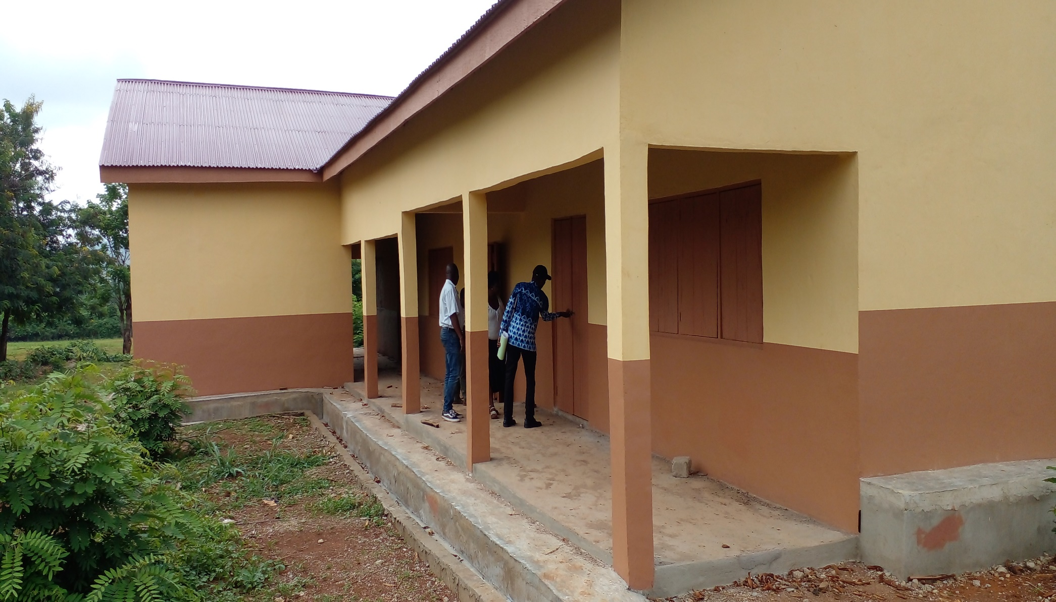
3 Unit classroom block at Sayeraso

Slide 20
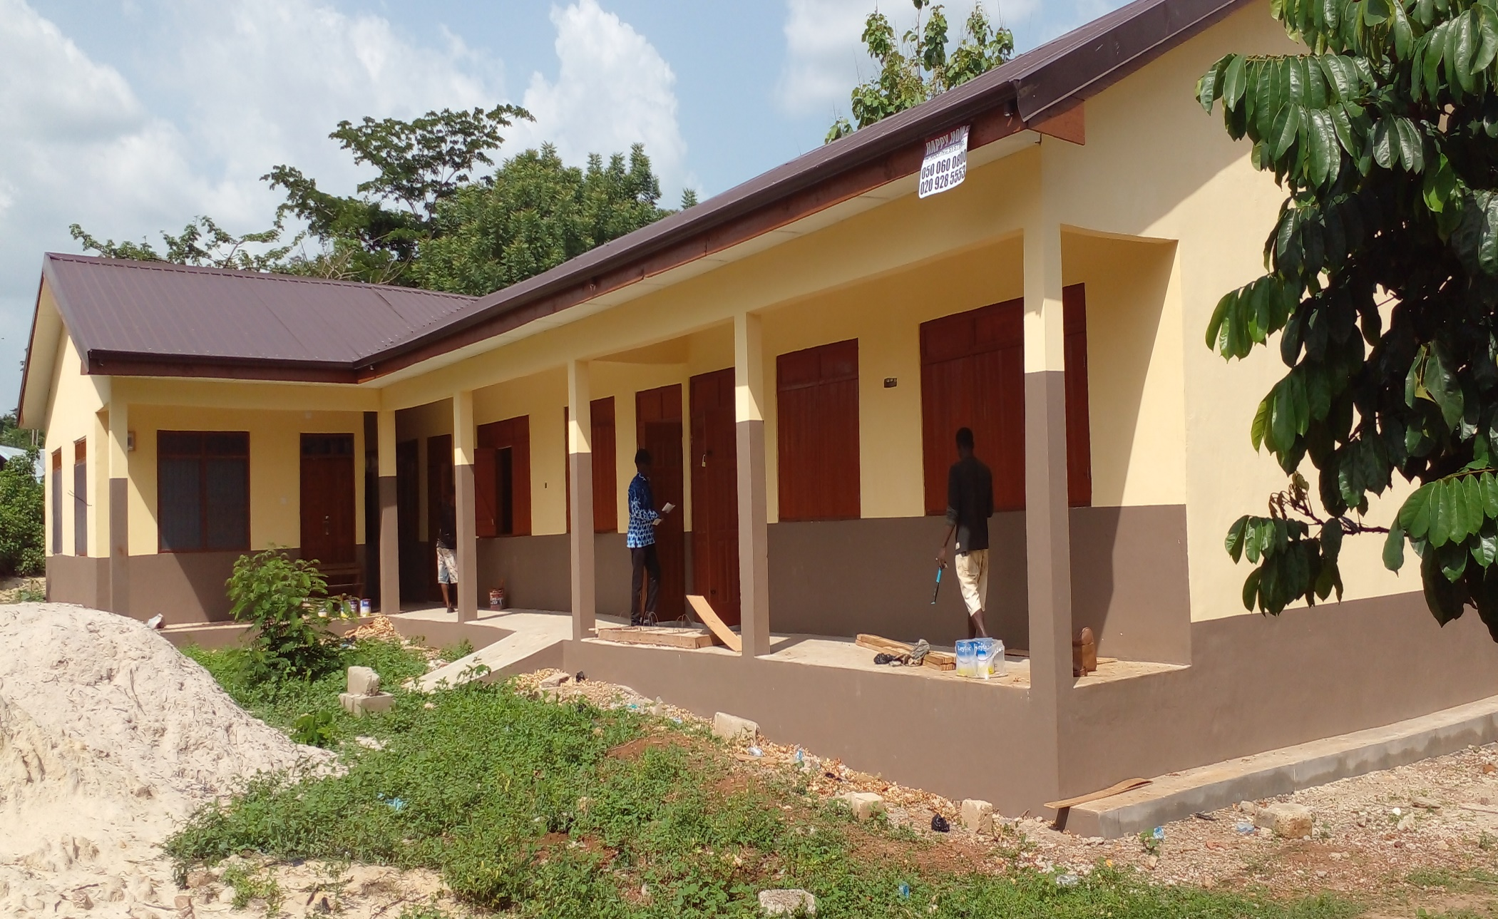
3 Unit classroom block at Danyame

Slide 21
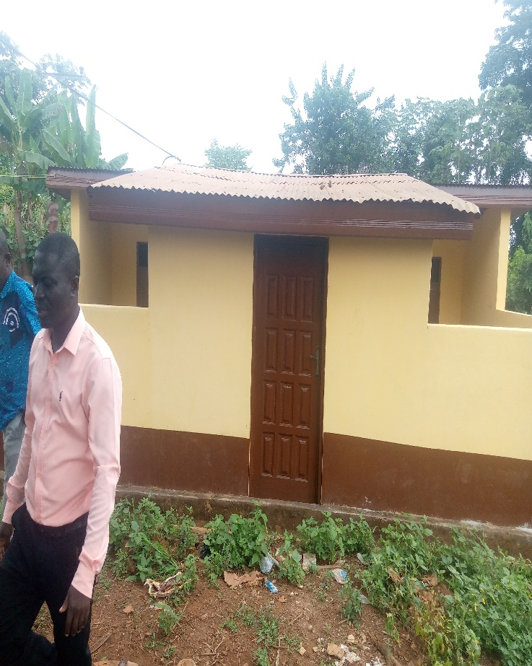
1No. 6 Seater WC toilet at Juaboso Magazine

Slide 22
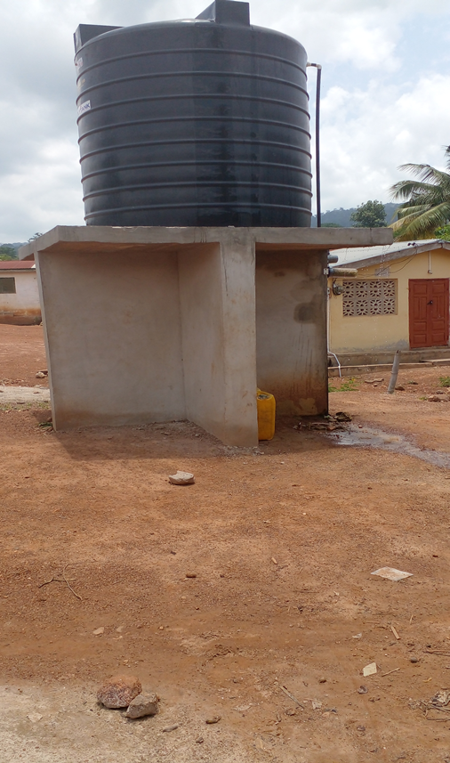
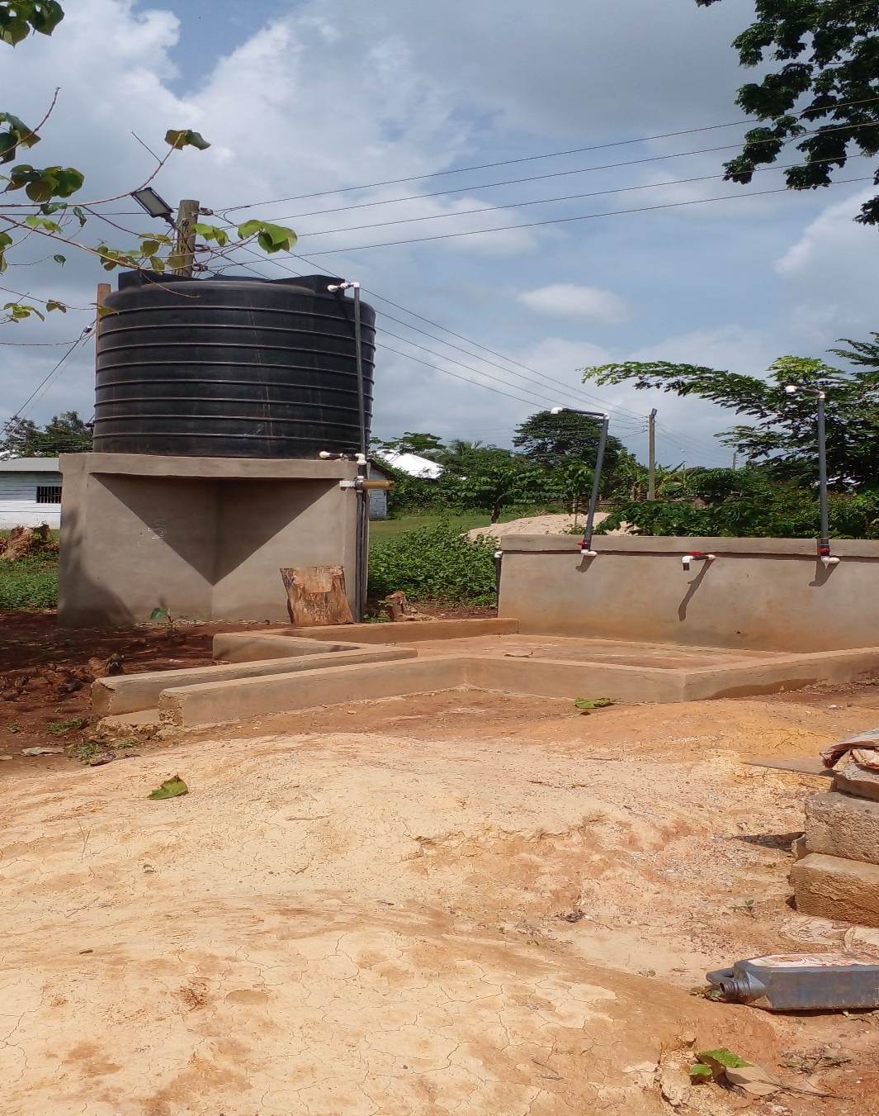
Mechanised boreholes at Dominibo and Boinzan

Slide 23

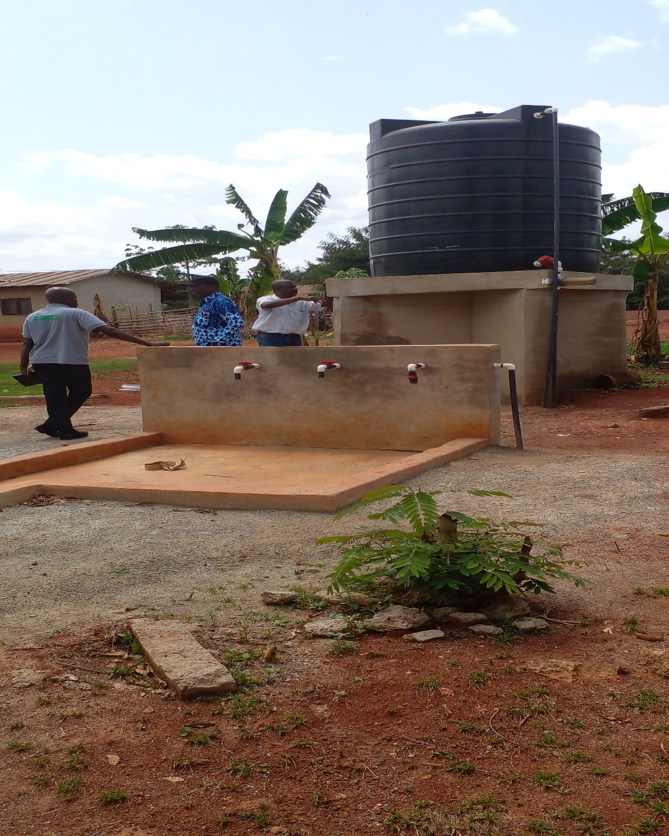
Mechanised borehole at New Berekum and Proso

Slide 24
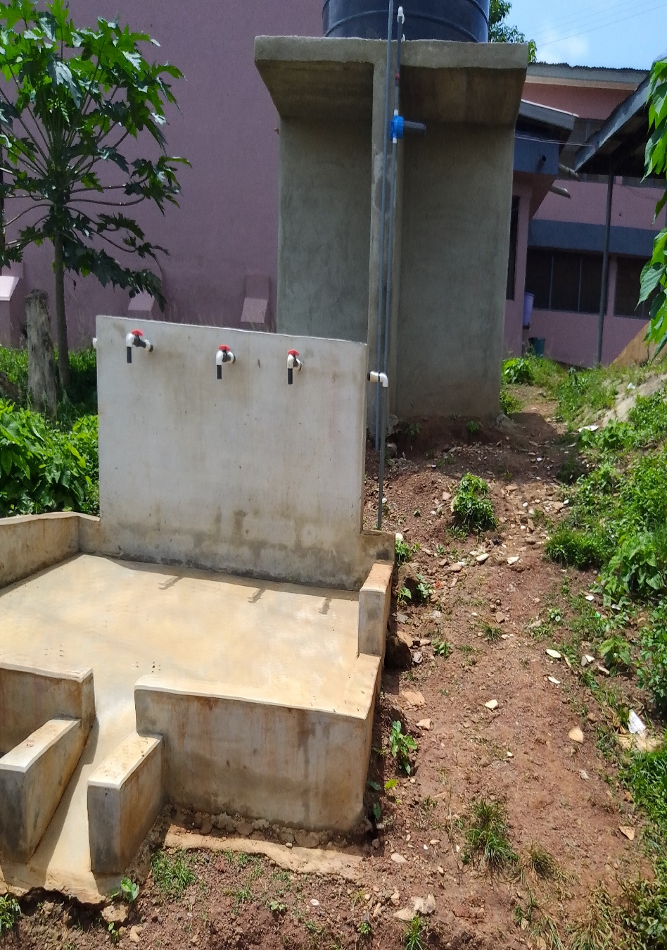
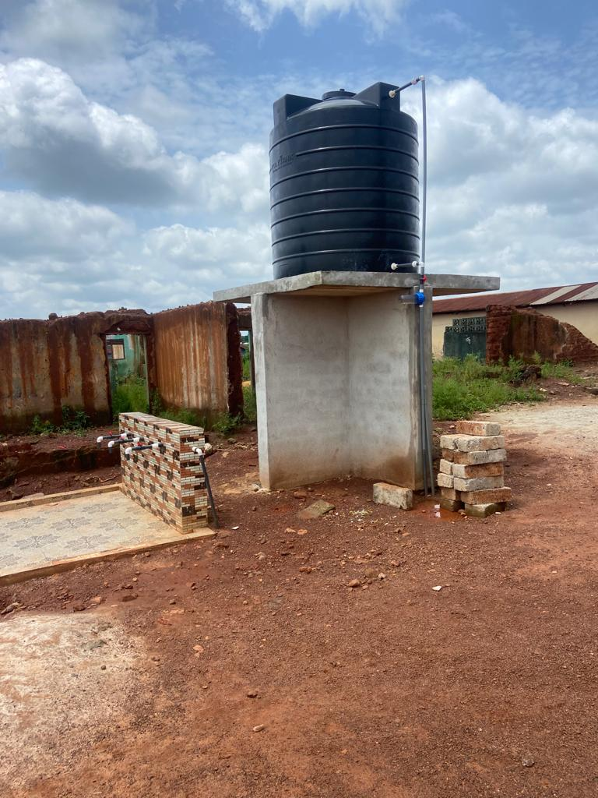
Mechanised borehole at Antobia and Juaboso

Slide 25
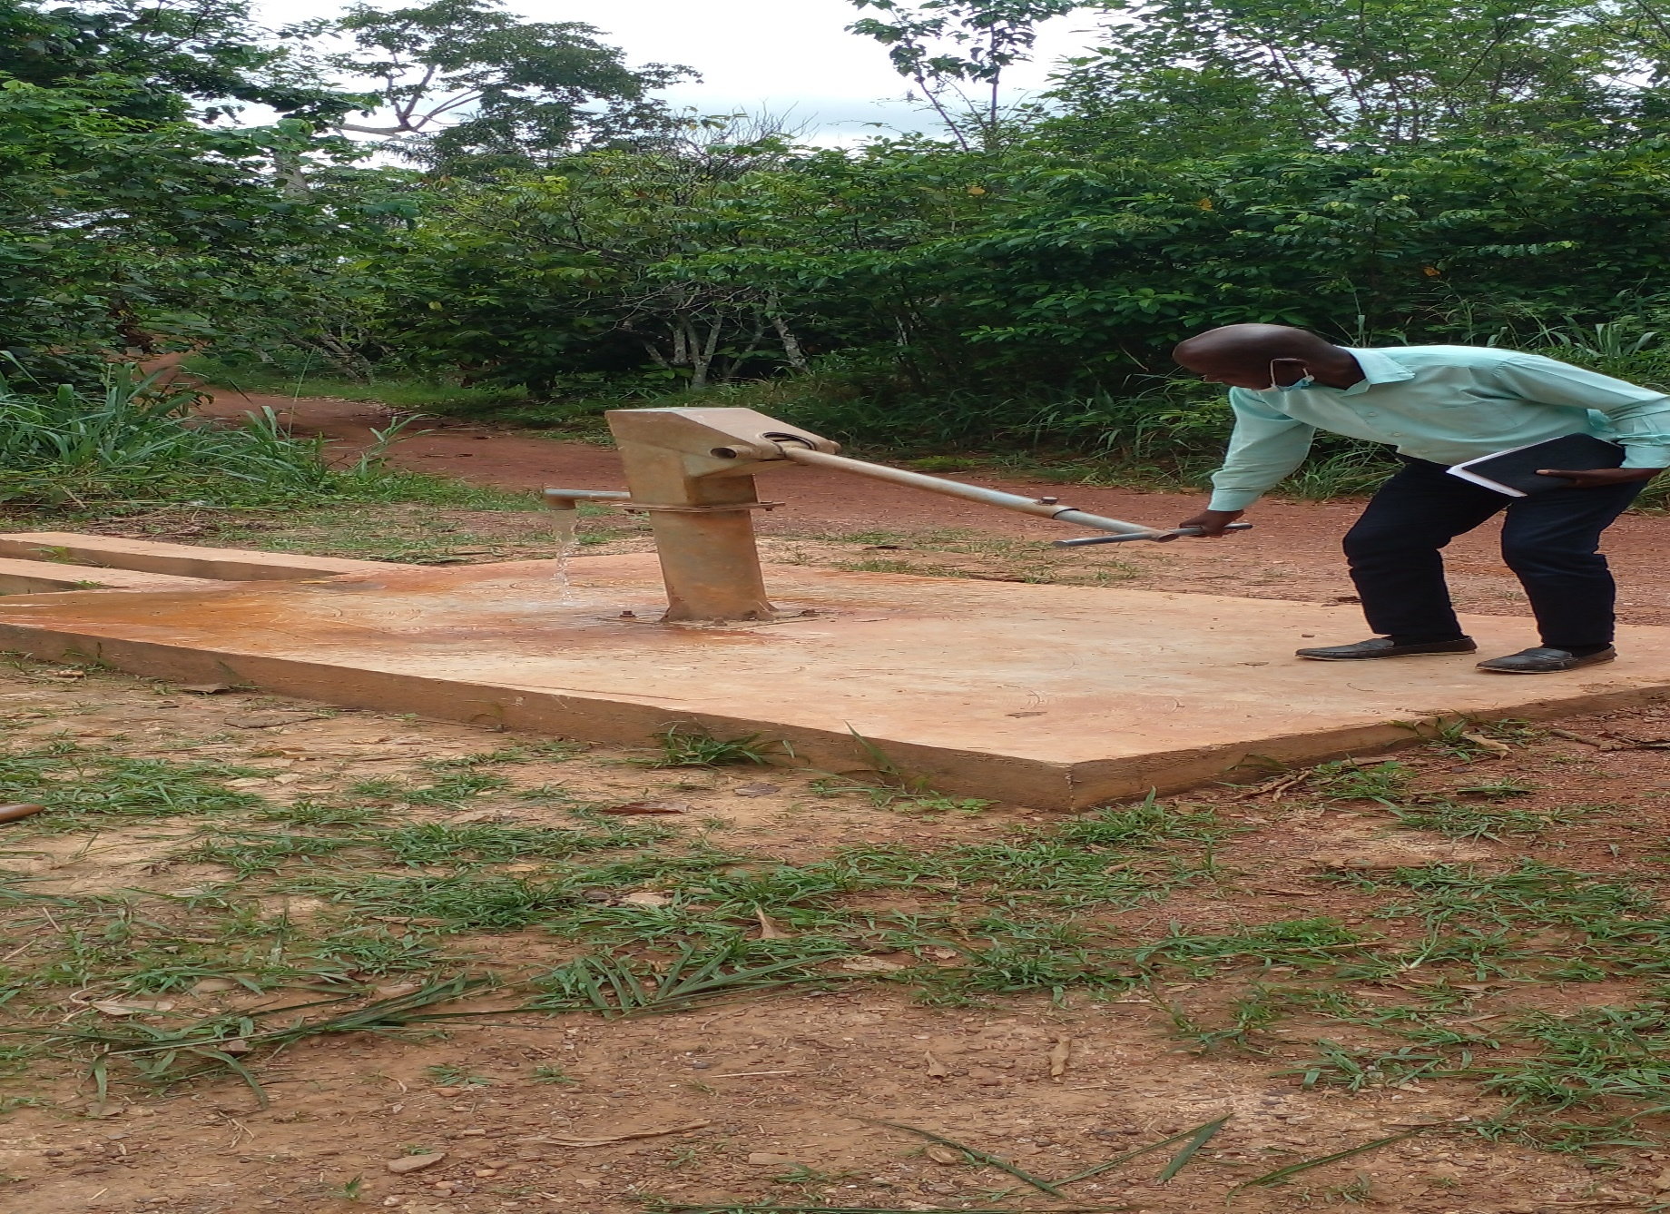
Drilled Borehole fitted with Pump at Sonka

Slide 26
Policy Outcome Indicators and Targets
OUTCOME INDICATOR DESCRIPTION | UNIT OF MEASUREMENT | Previous years performance (2021) |  | Current year’s actual performance (2022)
 |  | Target | Actual | Target | Actual as at August
Improved revenue generation (IGF) and expenditure management | Percentage increase in IGF | 10% | 8.1% | 10% | 5%
Improved electrification | Percentage of communities covered by electricity | 88% | 85 % | 91% | 87%
Level of adoption of new/modern technology | Adoption rate of new/modern technology by farmers | 85% | 80% | 90% | 81%
Agricultural yield increased | Yield per Hector (maize mt) | 2.0 | 1.82 | 2.0 | 1.68
 | Yield per hectare (rice mt) | 2.0 | 1.81 | 2.0 | 1.70
Improved Sanitation Management | Total volume of waste disposed | 170mt | 36.19mt | 170mt | 23.14mt
 | Percentage of population with access to proper toilet facilities | 70% | 57.6% | 72% | 60.9%

Slide 27
Policy Outcome Indicators and Targets
OUTCOME INDICATOR DESCRIPTION | UNIT OF MEASUREMENT | Previous years performance (2021) |  | Current year’s actual performance (2022)
 |  | Target | Actual | Target | Actual as at August
Improved water management system | Percentage of population with access to potable drinking water | 87.98% | 85.4% | 92.98% | 88.4%
Improved road networks | Percentage of road network in good condition | 78% | 40% | 70% | 55%
Increased Enrolment levels, performance Levels | Percentage Increase In Enrolment Levels | 10% | 1% | 10% | -
Increased performance at JHS level | Percentage Passes recorded in BECE | 95% | 86.4% | 95% | Awaiting
Gender Empowerment | No of women gainfully employed | 500 | 298 | 400 | 136

Slide 28
KEY PERFORMANCE INFORMATION FOR BUDGET PROGRAMMES
(MANAGEMENT AND ADMINISTRATION)
Key/Main Outputs | Output Indicator | Past Years
 |  | 2021 Target | 2021 Actual | 2022 Target | 2022 Actual (as at AUGUST)
Quarterly forums organized | 4 Quarterly forums held | 4 | 4 | 4 | 2
IGF mobilized | % Increased in IGF | 10% | 8.1% | 10% | 5%
(SOCIAL SERVICES DELIVERY)
Gender Empowerment | No of women trained and supported | 500 | 298 | 400 | 136
Improved access to Education | Number of school buildings constructed | 6 | 1 | 3 | 2
Environmental/Sanitation facilities improved | No. of toilet facilities constructed | 600 | 421 | 600 | 132
 | Frequency of Solid waste evacuated weekly | 4 | 2 | 4 | 2
Improved access to potable water | No. of Boreholes constructed | 10 | 6 | 10 | 7

Slide 29
KEY PERFORMANCE INFORMATION FOR BUDGET PROGRAMMES
Key/Main Outputs | Output Indicator | Past Years
 |  | 2021 Target | 2021 Actual | 2022 Target | 2022 Actual (as at AUGUST)
(INFRASTRUCTURE DELIVERY & MANAGEMENT)
Improved service delivery | Number of days to issue permit | 30 | 30 | 30 | 30
Communities accessibility improved | Kilometres of roads reshaped | 100km | 83km, | 75km, | 32km

Slide 30
KEY PERFORMANCE INFORMATION FOR BUDGET PROGRAMMES
(ECONOMIC DEVELOPMENT)
Key/Main Outputs | Output Indicator | Past Years
 |  | 2021 Target | 2021 Actual | 2022 Target | 2022 Actual (as at August)
Agricultural productivity improved | No. of hectors cultivated (maize) | 6230 | 6429 | 7000 | 6152
 | No. of hectors cultivated (rice) | 3,230 | 2,148 | 3,230 | 1,789
Trade competitiveness improved | Number of Entrepreneurs trained and assisted financially | 400 | 298 | 400 | 136
(ENVIRONMENTAL & SANITATION MANAGEMENT)
Disaster prevented and managed | % reduction in persons affected by disaster | 60% | 40% | 60% | 20%
 | No. of Hazards prevented | 20 | 10 | 20 | 9

Slide 31
SANITATION BUDGET PERFORMANCE
LIQUID WASTE
NO. | NAME OF ACTIVITY/PROJECT | BUDGET | ACT. @ AUG 2022
1. | Construction of 3 Seater KVIP and 3 Urinal at Pillar 290 | 182,647.63 | 177,327.80
2. | Construction of 3 Seater KVIP and 3 Urinal at Domi | 182,554.93 | 167,140.77
SOLID WASTE
1. | Maintenance of Final Disposal Site | 100,000.00 | 80,000.00
2. | Support towards National Sanitation Day | 20,000.00 | 0.00
3. | Fumigation/SIP | 350,000.00 | 0.00

Slide 32
DP SUPPORTED PEROGAMME (MAG)
NO. | NAME OF ACTIVITY/PROJECT | BUDGET | ACTUAL AS @ AUG 2022
1. | General maintenance and running of official Vehicle and motor Bikes | 36,459.80 | 36,459.80
2. | Training and Workshops organized by the district Directorate | 21,250.00 | 21,250.00
3. | Monthly and quarterly monitoring and supervision | 21,048.00 | 21,048.00
4. | Conduct demonstration on food Crops | 3,744.20 | 3,744.20
 | TOTAL | 82,502.00 | 82,502.00

Slide 33
GOVERNMENT FLAGSHIP PROJECTS/PROGRAMMES
NO. | NAME OF ACTIVITY/PROJECT | BUDGET | ACTUAL AS@ AUG 2021
1. | Support the implementation of Planting for Food and Jobs programme | 40,000.00 | 12,000.00
2. | Support the implementation of Planting for Export and Rural Development (PERD) | 35,000.00 | 0.00
3. | Planting for Food and Investment | 35,000.00 | 0.00

Slide 34
OUTLOOK FOR 2023

Slide 35
JUABOSO ADOPTED POLICY OBJECTIVES FOR 2023
FOCUS AREA | ADOPTED POLICY OBJECTIVES | BUDGET ALLOCATION
LOCAL GOVERNMENCE AND DECENTRALIZATION | Deepen political, financial and administrative decentralization | 1,820,427.42
PUBLIC POLICY MANAGEMENT | Enhance Capacity for policy formulation and Coordination | 1,000,407.4
HEALTH AND HEALTH SERVICE | Ensure accessible, and quality Universal Health Coverage (UHC) for all | 585,814.57
WATER AND SANITATION | Improve access to safe, reliable and sustainable water supply services for all | 385,949.29
EDUCATION AND TRAINING | Enhance equitable access to, and participation in quality education at all levels | 486,084.00

Slide 36
JUABOSO ADOPTED POLICY OBJECTIVES FOR 2022
FOCUS AREA | ADOPTED POLICY OBJECTIVES | BUDGET ALLOCATION
TRANSPORT INFRASTRUCTURE | Improve efficiency and effectiveness of road Transport infrastructure and Services | 872,934.27
HUMAN SETTLEMENT AND HOUSING | Promote sustainable, spatially integrated, balanced and orderly development of human settlement | 584,913.59
AGRICULTURE AND RURAL DEVELOPMENT | Modernize and enhance Agricultural Production Systems | 590,532.00
PRIVATE SECTOR DEVELOPMENT | Support entrepreneurs and Local Economic Development | 359,381.87
DISASTER MANAGEMENT | Promote Proactive Planning for disaster prevention and mitigation. | 14,000.00
TOTAL |  | 7,638,760.64

Slide 37
Policy Outcome Indicators and Targets
Outcome Indicator Description | Unit of Measurement | Previous year (2021) |  | Current year (2022) |  | Budget year (2023) | Indicative year (2024) | Indicative year (2025) | Indicative year (2026)
 |  | Target | Actual | Target | Actual as at August | Target | Target | Target | Target
Improved electrification | Percentage of communities connected with electricity | 88% | 85 % | 91% | 87% | 91% | 93% | 95% | 95%
Improved revenue generation (IGF) | Percentage increase in IGF | 10% | 8.1% | 10% | 5% | 12% | 13% | 15% | 15%
Level of adoption of new/modern technology | Adoption rate of new/modern technology by farmers | 85% | 75% | 75% | 81% | 95% | 95% | 95% | 95%

Slide 38
Policy Outcome Indicators and Targets
Outcome Indicator Description | Unit of Measurement | Previous year (2021) |  | Current year (2022) |  | Budget year (2023) | Indicative year (2024) | Indicative year (2025) | Indicative year (2026)
 |  | Target | Actual | Target | Actual as at August | Target | Target | Target | Target
Improved water management system | Percentage of population with access to potable drinking water | 87.98% | 87.4% | 92% | 88.4% | 93% | 93% | 94% | 94%
Improved road networks | Percentage of road network in good condition | 78% | 40% | 70% | 55% | 60% | 65% | 65% | 70%
Increased Enrolment levels, performance Levels | Percentage Increase In Enrolment Levels | 10% | 1% | 10% |  | 5% | 10% | 10% | 10%
Increased performance at JHS levels | Percentage Passes recorded in BECE | 95% | 84.4% | 95% | Awaiting | 95% | 95% | 96% | 96%

Slide 39
KEY PERFORMANCE INFORMATION FOR BUDGET PROGRAMMES
Key/Main Outputs | Output Indicator | Past Years |  |  |  | Projections
 |  | 2021 Target | 2021 Actual | 2022 Target | 2022 Actual as at 31st August |  | Indicative Year | Indicative Year | Indicative Year
 |  |  |  |  |  | 2023 | 2024 | 2025 | 2026
(Management and Administration)
General Assembly Meetings organized | Quarterly General Assembly Meetings | 4 | 4 | 4 | 2 | 4 | 4 | 4 | 4
IGF mobilized | Number of Trainings for revenue collectors | 2 | 2 | 3 | 1 | 3 | 3 | 3 | 4
(SOCIAL SERVICE DELIVERY)
Improved access to Education | Number of school building constructed | 6 | 1 | 6 | 2 | 2 | 2 | 2 | 3
Improved access to water and Sanitation | No. of Toilet facilities constructed | 600 | 421 | 600 | 132 | 450 | 500 | 500 | 500
 | Frequency of Solid waste evacuated weekly | 3 | 2 | 3 | 2 | 3 | 3 | 3 | 3
 | No. of Boreholes constructed | 10 | 6 | 10 | 7 | 10 | 10 | 10 | 10

Slide 40
KEY PERFORMANCE INFORMATION FOR BUDGET PROGRAMMES
Key/Main Outputs | Output Indicator | Past Years |  |  |  | Projections
 |  | 2021 Target | 2021 Actual | 2022 Target | 2022 Actual as at AUG | Budget Year | Indicative Year | Indicative Year | Indicative Year
 |  |  |  |  |  | 2023 | 2024 | 2025 | 2026
INFRASTRUCTURE DELIVERY & MANAGEMENT)
Communities accessibility improved | Kilometres of roads reshaped | 100km | 0km | 75km, | 27km, | 80KM | 100KM | 120KM | 140KM,
Improve service delivery | No of days to issue a permit | 30 | 30 | 30 | 30 | 30 | 30 | 30 | 30
Improved Electricity coverage | No. of communities with access to electricity | 132 | 110 | 142 | 132 | 145 | 155 | 160 | 165
(ECONOMIC)
Agricultural productivity improved | No. of Hect. (maize) No. of Hect. (Rice) | 6230 | 6229 | 7000 | 6152 | 6500 | 6500 | 6500 | 6500
 |  | 2320 | 2148 | 3230 | 1789 | 3500 | 3500 | 4000 | 4000
Trade competitiveness improved | Number of Entrepreneurs trained and supported | 400 | 298 | 400 | 250 | 400 | 400 | 500 | 550

Slide 41
KEY PERFORMANCE INFORMATION FOR BUDGET PROGRAMMES
(Environmental Development)
Key/Main Outputs | Output Indicator | Past Years |  |  |  | Projections
 |  | 2021 Target | 2021 Actual | 2022 Target | 2022 Actual @AUG | Budget Year | Indicative Year | Indicative Year | Indicative Year
 |  |  |  |  |  | 2023 | 2024 | 2025 | 2026
1.Disaster Managed | % reduction in persons affected by disaster | 60% | 40% | 60% | 20% | 60% | 65% | 65% | 60%
2. Disaster Prevented | No of hazards prevented | 20 | 10 | 20 | 9 | 20 | 25 | 25 | 20

Slide 42
2022-2025 REVENUE PROJECTIONS- IGF ONLY
ITEM | 2022 |  | 2023 | 2024 | 2025 | 2026
 | BUDGET | ACTUAL AS @ AUG | PROJECTION | PROJECTION | PROJECTION | PROJECTION
PROPERTY RATE | 152,000.00 | 24,000.00 | 179,500.00 | 197,450.00 | 211,271.50 | 221,835.08
BASIC RATE | 500.00 | - | 500.00 | 550.00 | 588.50 | 617.93
FEES | 152,400.00 | 113,420.62 | 160,000.00 | 176,000.00 | 188,320.00 | 197,736.00
FINES | 12,000.00 | 11,520.00 | 15,000.00 | 16,500.00 | 17,655.00 | 18,537.75
LICENCE | 311,900.00 | 255,960.62 | 370,000.00 | 407,000.00 | 435,490.00 | 457,264.50
LAND | 62,200.00 | 5,460.00 | 70,000.00 | 77,000.00 | 82,390.00 | 86,509.50
RENT | 87,000.00 | 50,340.07 | 90,000.00 | 99,000.00 | 105,930.00 | 111,226.50
MISC. | 800.00 | 532.00 | - | - | - | -
TOTAL | 778,800.00 | 461,233.31 | 885,000.00 | 973,500.00 | 1,041,645.00 | 1,093,727.25

Slide 43
2022-2025 REVENUE PROJECTIONS- ALL FUNDING SOURCES
ITEM | 2022 |  | 2023 | 2024 | 2025 | 2026
 | BUDGET | ACTUAL AS @ AUG | PROJECTION | PROJECTION | PROJECTION | PROJECTION
IGF | 778,800.00 | 461,233.31 | 885,000.00 | 973,500.00 | 1,041,645.00 | 1,093,727.25
COMPENSATION | 2,214,455.00 | 1,812,809.31 | 2,474,160.01 | 2,721,576.01 | 2,912,086.33 | 3,057,690.64
G&S TRANSFER | 101,865.00 | 12,753.31 | 56,000.00 | 61,600.00 | 65,912.00 | 69,207.60
ASSETS TRANSF. |  | - | - | - | - | -
DACF | 3,377,394.11 | 768,691.81 | 2,000,000.00 | 2,200,000.00 | 2,354,000.00 | 2,471,700.00
DACF-RFG | 1,164,502.04 | 963,487.39 | 1,164,502.00 | 1,280,952.20 | 1,370,618.85 | 1,439,149.79
MAG | 82,502.00 | 42,249.77 | 59,098.63 | 65,008.49 | 69,559.08 | 10,433.03
MP'S CF | 340,000.00 | 193,761.93 | 250,000.00 | 275,000.00 | 294,250.00 | 308,962.50
STOOL LANDS | 450,000.00 | 222,605.00 | 450,000.00 | 495,000.00 | 529,650.00 | 556,132.50
PWD | 140,730.00 | - | 100,000.00 | 110,000.00 | 117,700.00 | 123,585.00
Safety Net |  |  | 200,000.00 | 220,000.00 | 235,400.00 | 247,170.00
TOTAL | 8,650,248.15 | 4,477,591.83 | 7,638,760.64 | 8,402,636.70 | 8,990,821.26 | 9,377,758.31

Slide 44
EXPENDITURE BY BUDGET PROGRAMME AND ECONOMIC CLASSIFICATION –ALL FUNDING SOURCES
BUDGET PROGRAMME | AMOUNT GH
 | COMPENSATION OF EMPLOYEES | GOODS AND SERVICE | CAPITAL EXPENDITURE | TOTAL
MANAGEMENT AND ADMINISTRATION | 1,611,435.82 | 1,209,399.00 | - | 2,820,834.82
SOCIAL SERVICE DELIVERY | 282,112.09 | 973,000.00 | 1,141,052.00 | 2,396,164.09
INFRASTRUCTURE DELIVERY | 234,397.86 | 179,000.00 | 1,044,450.00 | 1,457,847.86
ECONOMIC DEVELOPMENT | 506,815.24 | 443,098.63 | - | 949,913.87
ENVIRONMENTAL MANAGEMENT | - | 14,000.00 | - | 14,000.00
TOTAL | 2,634,761.01 | 2,818,497.63 | 2,185,502.00 | 7,638,760.64

Slide 45
2023 EXPENDITURE BY BUDGET PROGRAMME, PROJECTS AND ECONOMIC CLASSIFICATION
BUDGET PROGRAMME | KEY PRIORITY PROJECT FOR 2023 | AMOUNT GH
 |  | GOODS AND SERVICE | CAPITAL EXPENDITURE | TOTAL
MANAGEMENT AND ADMINIS. | Train area council and provision of logistical support for area council | 40,000.00 |  | 40,000.00
 | Gazette Assembly bye-law. | 15,000.00 |  | 15,000.00
 | Organize Town Hall meeting | 15,000.00 |  | 15,000.00
SOCIAL SERVICE DELIVERY | Construction of 1No. 4unit Nurses Quarters at Bonsu Nkwanta |  | 26,000.00 | 26,000.00
 | Construction of CHPS compound at Sayerano |  | 30,000.00 | 30,000.00
 | Construction of 1No. 3unit classroom block, 3 seater KVIP, and 3 urinal at Danyame |  | 20,000.00 | 20,000.00

Slide 46
BUDGET PROGRAMME | KEY PRIORITY PROJECT | GOODS AND SERVICE | CAPITAL EXPENDITURE | TOTAL
INFRASTRUCTURE DELIVERY AND MANAGEMENT | Maintenance of Assembly Resident and Office Building |  | 40,000.00 | 40,000.00
 | Rehabilitation and completion of DCD,s Bungalow at Juaboso |  | 23,018.25 | 23,018.26
 | Extention of water to 8 seater WC at District Assembly Office |  | 35,550.00 | 35,550.00
ECONOMIC DEVELOPMENT | Construction of 1No. 12unit market shed at Sayerano |  | 20,000.00 | 20,000.00
 | Support the implementation of planting for food and Jobs | 30,000.00 |  | 30,000.00
 | Organize Annual National Farmers Day | 80,000.00 |  | 80,000.00
ENVIRONMENTAL MANAGEMENT | Support to Nadmo | 4,000.00 |  | 4,000.00

Slide 47
GOVERNMENT FLAGSHIP PROJECTS/PROGRAMMES FOR 2023
NO. | NAME OF ACTIVITY/PROJECT | BUDGET | FUNDING SOURCE
1. | Support the implementation of Planting for Food and Jobs programme | 30,000.00 | DACF
2. | Support for Planting for Export and Rural Development | 35,000.00 | DACF

Slide 48
2023-2026 EXPENDITURE PROJECTIONS BY ECONOMIC CLASSIFICATION – ALL FUNDING SOURCES
EXPENDITURE ITEMS | 2022 BUDGET | ACTUAL | 2023 | 2024 | 2025 | 2026
 |  | ACTUAL AS @ AUG
COMPENSATION | 2,368,856.19 | 2,064,640.46 | 2,634,761.01 | 2,898,237.11 | 3,101,113.71 | 3,256,169.40
GOODS AND SERVICE | 3,017,203.00 | 1,158,881.19 | 2,798,497.63 | 3,078,347.39 | 3,293,831.71 | 3,458,523.30
ASSESTS | 3,264,188.96 | 1,254,070.18 | 2,205,502.00 | 2,426,052.20 | 2,595,875.85 | 2,725,669.64
TOTAL | 8,650,248.15 | 4,477,591.83 | 7,638,760.64 | 8,402,636.70 | 8,990,821.27 | 9,440,362.34

Slide 49
SUMMARY OF EXPENDITURE BUDGET BY DEPARTMENT, ITEM AND FUNDING SOURCES-2022
No. | DEPARTMENT | COMPENSATION | GOODS & SERVICE | ASSETS | TOTAL | FUNDING (indicate amount against the funding source)
 |  |  |  |  |  | IGF | GOG | DACF | DACF-RFG | DACF-MP | MAG | PWD | STOOL LANDS | SAFETY NET | TOTAL
1. | Central Administration | 1,450,611.25 | 1,187,399.00 | - | 2,638,010.25 | 594,000.00 | 1,290,010.25 | 384,000.00 | 55,000.00 | 15,000.00 |  |  | 300,000.00 |  | 2,638,010.25
2. | Works dept. | 199,241.07 | 154,000.00 | 1,044,450.00 | 1,397,691.07 | 12,000.00 | 211,241.07 | 429,450.00 | 450,000.00 | 145,000.00 |  |  | 150,000.00 |  | 1,397,691.07
3. | Dept. of Agric | 506,815.24 | 428,098.63 |  | 934,913.87 | 12,000.00 | 518,815.24 | 145,000.00 |  |  | 59,098.63 |  |  | 200,000.00 | 934,913.87
4. | Dept. of SW | 84,179.15 | 95,000.00 |  | 179,179.15 | 15,000.00 | 94,179.15 |  |  |  |  | 70,000.00 |  |  | 179,179.15
5. | Trade | - | 15,000.00 |  | 15,000.00 | 5,000.00 |  | 10,000.00 |  |  |  |  |  |  | 15,000.00
6. | Finance | 78,705.34 | - | - | 78,705.34 |  | 78,705.34 |  |  |  |  |  |  |  | 78,705.34
7. | Education | - | 250,000.00 | 598,502.00 | 848,502.00 | 15,000.00 |  | 354,000.00 | 359,502.00 | 90,000.00 |  | 30,000.00 |  |  | 848,502.00
8. | NAD | - | 14,000.00 |  | 14,000.00 | 10,000.00 |  | 4,000.00 |  |  |  |  |  |  | 14,000.00
9. | HR | 30,207.91 | 11,000.00 |  | 41,207.91 | 5,000.00 | 36,207.91 |  |  |  |  |  |  |  | 41,207.91
10 | Stats | 51,911.32 | 11,000.00 |  | 62,911.32 | 5,000.00 | 57,911.32 |  |  |  |  |  |  |  | 62,911.32
11 | Physical | 35,156.79 | 25,000.00 |  | 60,156.79 | 15,000.00 | 45,156.79 |  |  |  |  |  |  |  | 60,156.79
12 | Health | 197,932.94 | 628,000.00 | 542,550.00 | 1,368,482.94 | 197,000.00 | 197,932.94 | 673,550.00 | 300,000.00 |  |  |  |  |  | 1,368,482.94
 | Total | 2,634,761.01 | 2,818,497.63 | 2,185,502.00 | 7,638,760.64 | 885,000.00 | 2,530,160.01 | 2,000,000.00 | 1,164,502.00 | 250,000.00 | 59,098.63 | 100,000.00 | 450,000.00 | 200,000.00 | 7,638,760.64

Slide 50
PROJECTS FOR 2023 AND THEIR CORRESPONDING COST AND JUSTIFICATION
LIST OF ALL PROJECTS | IGF | GOG | DACF | DACF-RFG | MP | STOOLLAN. | UNICEF | MAG | SAFETY | TOTAL | JUSTIFICATION
Construction of 1No. 12unit market shed at Sayerano |  |  | 20,000.00 |  |  |  |  |  |  | 20,000.00 | To help marketers sell their product in the District
Construction of 12unit Lockable stores at Juaboso |  |  | 15,000.00 |  |  |  |  |  |  | 15,000.00 | To help marketers sell their product in the District
Construction of 1No 4unit Nurses Quarters at Bonsu Nkwanta |  |  | 26,000.00 |  |  |  |  |  |  | 26,000.00 | To provide shelter for staff’s who live far away from the District
Reactivation and Completion of 1No. 6unit classroom Block at Benchima |  |  | 62,000.00 |  |  |  |  |  |  | 62,000.00 | To ensure quality teaching and learning
Construction of 6No. Borholes at Onyinakrom, Asoredanho, Yiemfo,Pusi,Ensonyameye,Camp 5 |  |  | 30,000.00 |  |  |  |  |  |  | 30,000.00 | To help provide safe water to people in the District
Construction of CHPS compound at Sayerano |  |  | 30,000.00 |  |  |  |  |  |  | 30,000.00 | To help provide quality health services
Construction of 1No. 3unit Classroom Block, office with ancillary facilities at Komeamaa |  |  | 14,000.00 |  |  |  |  |  |  | 14,000.00 | To help provide quality teaching and learning
Construction of 1No. 6unit Classroom Block with ancillary facilities at Yawagyiemkrom |  |  | 35,000.00 |  |  |  |  |  |  | 35,000.00 | To help provide quality teaching and learning
Construction of 1No. 6unit Classroom Block with Ancilary Facilities at Dominibo |  |  | 40,000.00 |  |  |  |  |  |  | 40,000.00 | To help provide quality teaching and learning

Slide 51
PROJECTS FOR 2022 AND THEIR CORRESPONDING COST AND JUSTIFICATION
LIST OF ALL PROJECTS | IGF | GOG | DACF | DACF-RFG | MP | STOOLLAND. | UNICEF | MAG | SAFETY | TOTAL | JUSTIFICATION-
Completion of 1No. 6unit classroom block with office and store at Eteso |  |  | 60,000.00 |  |  |  |  |  |  | 60,000.00 | To help provide quality teaching and learning
Construction of 1No. 3unit classroom block at Mantukwa |  |  | 8,000.00 |  |  |  |  |  |  | 8,000.00 | To help provide quality teaching and learning
Construction of 1No. 3unit classroom block, 3 seater KVIP and 3 urinal at Danyame |  |  | 20,000.00 |  |  |  |  |  |  | 20,000.00 | To help provide quality teaching and learning
Maintenance of Assembly Residence and office Building |  |  | 91,431.74 |  |  |  |  |  |  | 91,431.74 | To help maintain Assembly’s Residence and Office Building
Rehabilitation and Completion of DCD’s Bungalow at Juaboso |  |  | 23,018.26 |  |  |  |  |  |  | 23,018.26 | To
Extension of water to 8 seater WC at District Assembly Office |  |  | 35,550.00 |  |  |  |  |  |  | 35,550.00 | To help provide water for the Assembly for office use
Maintenance and Rehabilitation of feeder roads |  |  | 20,000.00 |  |  |  |  |  |  | 20,000.00 | To help transport people from and to the District
Construction of 1No. 12unit market shed at Boinzan Market |  |  |  | 300,000.00 |  |  |  |  |  | 300,000.00 | This is to aid marketers sell their products

Slide 52
PROJECTS FOR 2022 AND THEIR CORRESPONDING COST AND JUSTIFICATION
LIST OF ALL PROJECTS | IGF | GOG | DACF | DACF-RFG | MP | STOOLLAND. | UNICEF | MAG | SAFETY | TOTAL | JUSTIFICATION-
Reshaping of roads (56km) Aboboyaa - Yawagyiem |  |  |  | 150,000.00 |  |  |  |  |  | 150,000.00 | This is to help people transport from and to the District
Construction of 1No. 3unit classroom at Nkra and Supply of 150 mono desk, 45 dual desk |  |  |  | 359,502.00 |  |  |  |  |  | 359,502.00 | To help from quality teaching and learning
Construction of CHPS compound at Kefas |  |  |  | 300,000.00 |  |  |  |  |  | 300,000.00 | To help provide quality health service to the community
Maintenance of water systems |  |  |  |  | 15,000.00 |  |  |  |  | 15,000.00 | To help maintain and provide safe water to the community
Construction of 5No. Mechanised borehole |  |  |  |  |  | 150,000.00 |  |  |  | 150,000.00 | To help provide quality water to the various vicinity

Slide 53
SANITATION BUDGET
LIQUID WASTE
1. | Extension of Water to 8-Seater WC at District Assembly Office | 35,550.00
2. | Construction of Urinal Bay at Proso Market | 77,000.00
SOLID WASTE
1. | Maintenance of Final Disposal Site | 100,000.00
2. | Purchase of Sanitation Equipment | 20,000.00
3 | Support toward National Sanitation Day | 20.000.00
4. | Provision for Fumigation/SIP | 350,000.00

Slide 54
DONOR PARTNER (DP) SUPPORT PROGRAMME (MAG)
NO. | NAME OF ACTIVITY/PROJECT | BUDGET
1. | Monitoring and Evaluation | 40,300.00
2. | Fuel | 4,000.00
3. | Training Materials | 10,000.00
4. | Meetings /Seminars | 7,080.00
5. | Maintenance of Official Vehicle | 7,618.63
 | Total | 59,098.63

Slide 55
DONOR PARTNER (DP) SUPPORT PROGRAMME (SAFETY NET)
NO. | NAME OF ACTIVITY/PROJECT | BUDGET
1. | Purchase of Materials and Equipment | 100,000.00
2. | Purchase of Fuel and payment of Allowance for M& E Activities | 100,000.00
 | TOTAL | 200,000.00

Slide 56
JUABOSO – COMPENSATION OF EMPLOYEES
NO. | DEPARTMENT | STAFF STRENGTH | MONTHLY SALARY | ANNUAL SALARY
1. | CENTRAL ADMINISTRATION | 57 | 107,500.86 | 1,290,010.25
2. | FINANCE | 5 | 2,505.56 | 30,066.75
3. | WORKS DEPARTMENT | 7 | 16,603.42 | 199,241.07
4. | SOCIAL WELFARE AND COMMUNITY DEV’T | 3 | 7,014.93 | 84,179.15
5. | ENVIRONMENTAL HEALTH DEPT. | 8 | 16,494.41 | 197,932.94
6. | AGRIC. DEPT. | 18 | 18,127.10 | 217,525.15
7. | STATISTICS | 2 | 4,325.94 | 51,911.32
8. | HUMAN RESOUCE | 1 | 2,517.33 | 30,207.91
9. | PHYSICAL PLANNING | 1 | 2,929.73 | 35,156.79
 | TOTAL | 102 |  | 2,474,160.01

Slide 57
JUABOSO – COMPENSATION OF CASUAL (IGF) STAFF
NO. | DEPARTMENT | STAFF STRENGTH | MONTHLY SALARY | ANNUAL SALARY
1. | CENTRAL ADMINISTRATION | 9 | 4,469.10 | 53,629.20
 | TOTAL | 9 |  | 53,629.20
 | GRAND TOTAL | 111 |  | 2,527,789.21

Slide 58
THANK YOU
© 2018. All rights reserved. No part of this publication may be stored in a retrieval system or transmitted in any or by any means, electronic, mechanical, photocopying, recording or otherwise without the prior written permission of the Ministry of Finance

