Slide 1


JUABOSO DISTRICT ASSEMBLY
2024-2027 COMPOSITE BUDGET
PRESENTED BY HON. GODFRED KWABENA AGYEI
DISTRICT CHIEF EXECUTIVE
ON
16TH OCTOBER, 2023

Slide 2
Outline of the Presentation
Introduction
Strategic Overview of the MMDA
Financial Performance – Revenue
- Expenditure
Key Achievements for 2023
2023 Budget Programme Performance
Outlook for 2024-2027

Slide 3
INTRODUCTION
Juaboso District Assembly was established by Legislative Instrument LI (2020) in 2012.
District Capital - Sefwi Juaboso
Electoral Areas-16
25 Assembly Members , 7 Government Appointees , 16 Elected, District Chief Executive and Member of Parliament
The District Shares Boundary with Bia West to the north, Asunafo South and sefwi wiawso municipal to the East, Bodi District to the South, La cote D’ivoire and Suaman to the West.
VISION STATEMENT
“To be among the first class Districts in the Country”
MISSION STATEMENT
“Juaboso District Assembly (JDA) exists to raise the living standards of the people through formulation and implementation of policies in partnership with local development stakeholders to improve access to basic services and create opportunities for wealth creation”.
CORE FUNCTIONS
Exercise political and administrative authority in the District.
Promote local economic development.
Exercise deliberative, legislative and executive functions

Slide 4
POPULATION
According to the 2021 Population and Housing Census, the population of the District was 88,814 with a growth rate of 2.0% , 52.4% representing males and 47.6% females.
ECONOMY OF THE DISTRICT
Agriculture is the main economic activity in the District. It employs about 76.2%
15.3% are in craft and other related trades.
8.5% are in services, commerce and trade.
ROADS
There are about 241.5 kms of engineered roads in the District.
78.5 kms of this road are tarred and 163 untarred.
EDUCATION:
Juaboso District has Nine (9) educational circuits.
282 Schools (105 KGs, 106 Primary Sch. and 69 JHS)
One (1) public and one (1)private Senior High Schools.
Gross Enrolment rate stands at 158.4% with 154.7% for males and 162.2% for females
Gender Parity Index (GPI) on GER stands at 0.98%

Slide 5
INTRODUCTION
HEALTH:
One (1) Government Hospital, One (1) Private Hospital, Two (2) Health Centre, Eight (8) Maternity homes
Thirty six (36 ) CHPS compounds.
The Doctor patient ratio stands at 1:19,881
SANITATION:
About 76.5% of households dispose their solid waste at public dumps and 23.5% dump indiscriminately
61.2% have access to the toilet facilities in their houses, whiles 7.2 shares the facility with them and 31.6% do not use any of the facilities.
TOURISM:
The only tourist site identified in the district is the Boinzan waterfalls which is yet to be developed.

Slide 6
KEY CHALLENGES/ISSUES
1. | Deplorable nature of Feeder roads.
2. | Inadequate Potable water facilities.
3. | Inadequate Market facilities.
4. | Inadequate Educational and Health Facilities.
5. | Insufficient Agric Extension officers
6. | Inadequate Sanitary Facilities and Drainage system

Slide 7
 | ADOPTED POLICY OBJECTIVES
 | Deepen political, financial and administrative decentralization
 | Enhance Capacity for policy formulation and Coordination
 | Enhance equitable access to, and participation in quality education at all levels
 | Ensure accessible, and quality Universal Health Coverage (UHC) for all
 | Improve access to safe and reliable water supply services for all
 | Improve efficiency and effectiveness of road Transport Infrastructure and Service
 | Modernize and enhance Agricultural Production System.
 | Support Entrepreneurs and Local Economic Development.
 | Promote sustainable, spatially integrated, balanced and orderly development of human settlement

Slide 8
FINANCIAL PERFORMANCE -REVENUE
REVENUE PERFORMANCE – IGF ONLY
ITEM | 2021 |  | 2022 |  | 2023 |  | %PER @AUG
 | BUDGET | ACTUAL | BUDGET | ACTUAL | BUDGET | ACT.@ AUG
PROPE. RATE | 87,000.00 | 84,462.00 | 152,000.00 | 18,941.81 | 89,000.00 | 76,000.00 | 85.39
BASIC RATE | 500.00 | - | 500.00 | 200.00 | 1,000.00 | 308.00 | 30.80
FEES | 91,920.00 | 98,588.00 | 152,400.00 | 146,083.62 | 150,000.00 | 98,081.00 | 65.39
FINES | 16,295.05 | 9,186.00 | 12,000.00 | 11,520.00 | 12,000.00 | 7,370.00 | 61.42
LICENCE | 124,672.84 | 92,966.00 | 311,900.00 | 345,722.71 | 340,000.00 | 224,334.47 | 65.98
LAND | 70,200.00 | 60,010.00 | 62,200.00 | 31,890.00 | 62,000.00 | 32,172.75 | 51.89
RENT | 15,341.62 | 80,322.17 | 87,000.00 | 51,897.06 | 90,000.00 | 43,847.24 | 48.72
MISC. | - | 13,403.28 | 800.00 |  | - | - | -
SUB-TOTAL | 405,929.51 | 438,937.45 | 778,800.00 | 606,255.20 | 744,000.00 | 482,113.46 | 64.80
STOOLLAND | 294,000.00 | 228,879.00 | 450,000.00 | 333,305.00 | 450,000.00 | 236,999.52 | 52.67
TOTAL | 699,929.51 | 667,816.45 | 1,228,800.00 | 939,560.20 | 1,194,000.00 | 719,112.98 | 60.23

Slide 9
FINANCIAL PERFORMANCE-REVENUE
REVENUE PERFORMANCE –ALL REVENUE SOURCES
ITEMS | 2021 |  | 2022 |  | 2023 |  | % PERFORM
 | BUDGET | ACTUAL | BUDGET | ACTUAL | BUDGET | ACTUAL @ AUG
IGF | 699,929.51 | 667,816.45 | 1,228,800.00 | 939,560.20 | 1,194,000.00 | 719,112.98 | 60.23
COMP. TRANSFER | 1,866,022.76 | 2,604,375.62 | 2,355185.00 | 2,604,375.62 | 3,609,807.40 | 2,623,598.82 | 72.68
G&S TRANSFER | 89,410.00 | 63,391.34 | 101,865.00 | 101,865.00 | 56,000.00 | 26,578.75 | 47.46
DACF | 2,968,724.00 | 699,767.42 | 3,377,394.11 | 788,511.46 | 2,000,000.00 | 535,235.12 | 26.76
DACF-RFG | 222,433.78 | 317,059.00 | 1,164,502.04 | 1,164,502.40 | 1,164,502.04 | - | -
MP'S CF | 340,000.00 | 294,652.07 | 340,000.00 | 378,889.98 | 490,000.00 | 398,362.66 | 81.30
MAG | 107,454.00 | 99,661.80 | 82,502.00 | 82,501.59 | 59,098.63 | 59,098.63 | 100.00
SAFETY NET |  |  |  |  | 200,000.00 | 50,000.00 | 25.00
PWD |  |  |  |  | 100,000.00 | 48,246.48 | 48.25
CARBON CREDIT |  |  |  |  | 59,098.63 | 94,186.85 | 159.37
TOTAL | 6,293,974.05 | 4,746,723.70 | 8,650,248.15 | 6,060,206.25 | 8,932,506.70 | 4,554,420.29 | 50.99

Slide 10
FINANCIAL PERFORMANCE - EXPENDITURE
EXPENDITURE PERFORMANCE (ALL DEPARTMENTS) IGF ONLY
EXPENDITURE | 2021 |  | 2022 |  | 2023
 | BUDGET | ACTUAL | BUDGET | ACTUAL | BUDGET | ACT. @ AUG | % PERFORM
COMPENSATION | 122,000.00 | 78,052.69 | 154,401.19 | 202,893.35 | 117,801.00 | 37,945.30 | 32.21
GOODS&SERVICE | 208,743.61 | 305,648.76 | 468,638.81 | 373,693.85 | 477,399.00 | 371,917.16 | 77.90
ASSETS | 75,185.90 | 55,236.00 | 155,760.00 | 78,511.46 | 148,800.00 | 72,251.00 | 48.56
TOTAL | 405,929.51 | 438,937.45 | 778,800.00 | 606,255.20 | 744,000.00 | 482,113.46 | 64.80

Slide 11
FINANCIAL PERFORMANCE-EXPENDITURE
EXPENDITURE PERFORMANCE (ALL DEPARTMENTS) ALL FUNDING SOURCES
EXPENDITURE | 2021 |  | 2022 |  | 2023
 | BUDGET | ACTUAL | BUDGET | ACTUAL | BUDGET | ACT @ AUG | % PERFORM.
COMPENSATION | 1,988,659.76 | 2,726,712.67 | 2,368,856.19 | 2,807,268.97 | 3,727,608.40 | 2,444,483.56 | 65.58
GOODS&SERVICE | 1,854,475.61 | 1,321,682.08 | 3,017,203.00 | 2,103,308.88 | 2,755,339.05 | 1,158,017.00 | 42.03
ASSETS | 2,450,838.81 | 698,328.95 | 3,264,188.96 | 1,149,628.40 | 2,449,559.25 | 931,919.73 | 38.04
TOTAL | 6,293,974.18 | 4,746,723.70 | 8,650,248.15 | 6,060,206.25 | 8,932,506.70 | 4,534,420.29 | 50.73

Slide 12
2023 BUDGET PROGRAMME PERFORMANCE
BUDGET PROGRAMME | BUDGET | ACTUAL AS @ AUG 2023
MANAGEMENT AND ADMINISTRATION | 3,022,261.06 | 1,416,325.29
SOCIAL SERVICE DELIVERY | 3,413,710.40 | 1,575,448.32
INFRASTRUCTURE DELIVERY AND MANAGEMENT | 1,507,060.50 | 982,464.79
ECONOMIC DEVELOPMENT | 930,079.40 | 535,853.36
ENVIRONMENTAL MANAGEMENT | 59,395.34 | 24,328.53
TOTAL | 8,932,506.70 | 4,534,420.29

Slide 13
FINANCIALS 2023 KEY PROJECTS AND PROGRAMMES FROM ALL SOURCES
NO. | NAME OF PROJECT | AMOUNT BUDGETED | ACT. PAYMENT @ AUG, 2023 | OUTSTANDING PAYMENT
1. | Construction of 1No. 3unit classroom block with KVIP at Brekrom | 330,000.00 | 297,000.00 | 33,000.00
2. | Drilling and Mechanization of 4No. Boreholes and 1no hand pump at Boinzan, Dominibo, Kofikrom, south Sonka and New Brekum | 165,000.00 | 159,929.74 | 5,070.26
3. | Provision for My First Day at School | 8,000.00 | 8,000.00 | 0.00
4. | Construction of 1No. CHIPS Compound at Juaboso Nkwanta | 430,000.00 | 350,376.45 | 79,623.55
6. | Organize Independence Day Celebration | 75,000.00 | 75,000.00 | 0.00
7. | Support to DPCU activities (Monitoring & Evaluation) | 10,000.00 | 9,000.00 | 1,000.00
9. | Renovation of Juaboso Market | 100,000.00 | 44,000.00 | 56,000.00

Slide 14
NON FINANCIAL PERFORMANCE BY PROGRAMMES

Slide 15
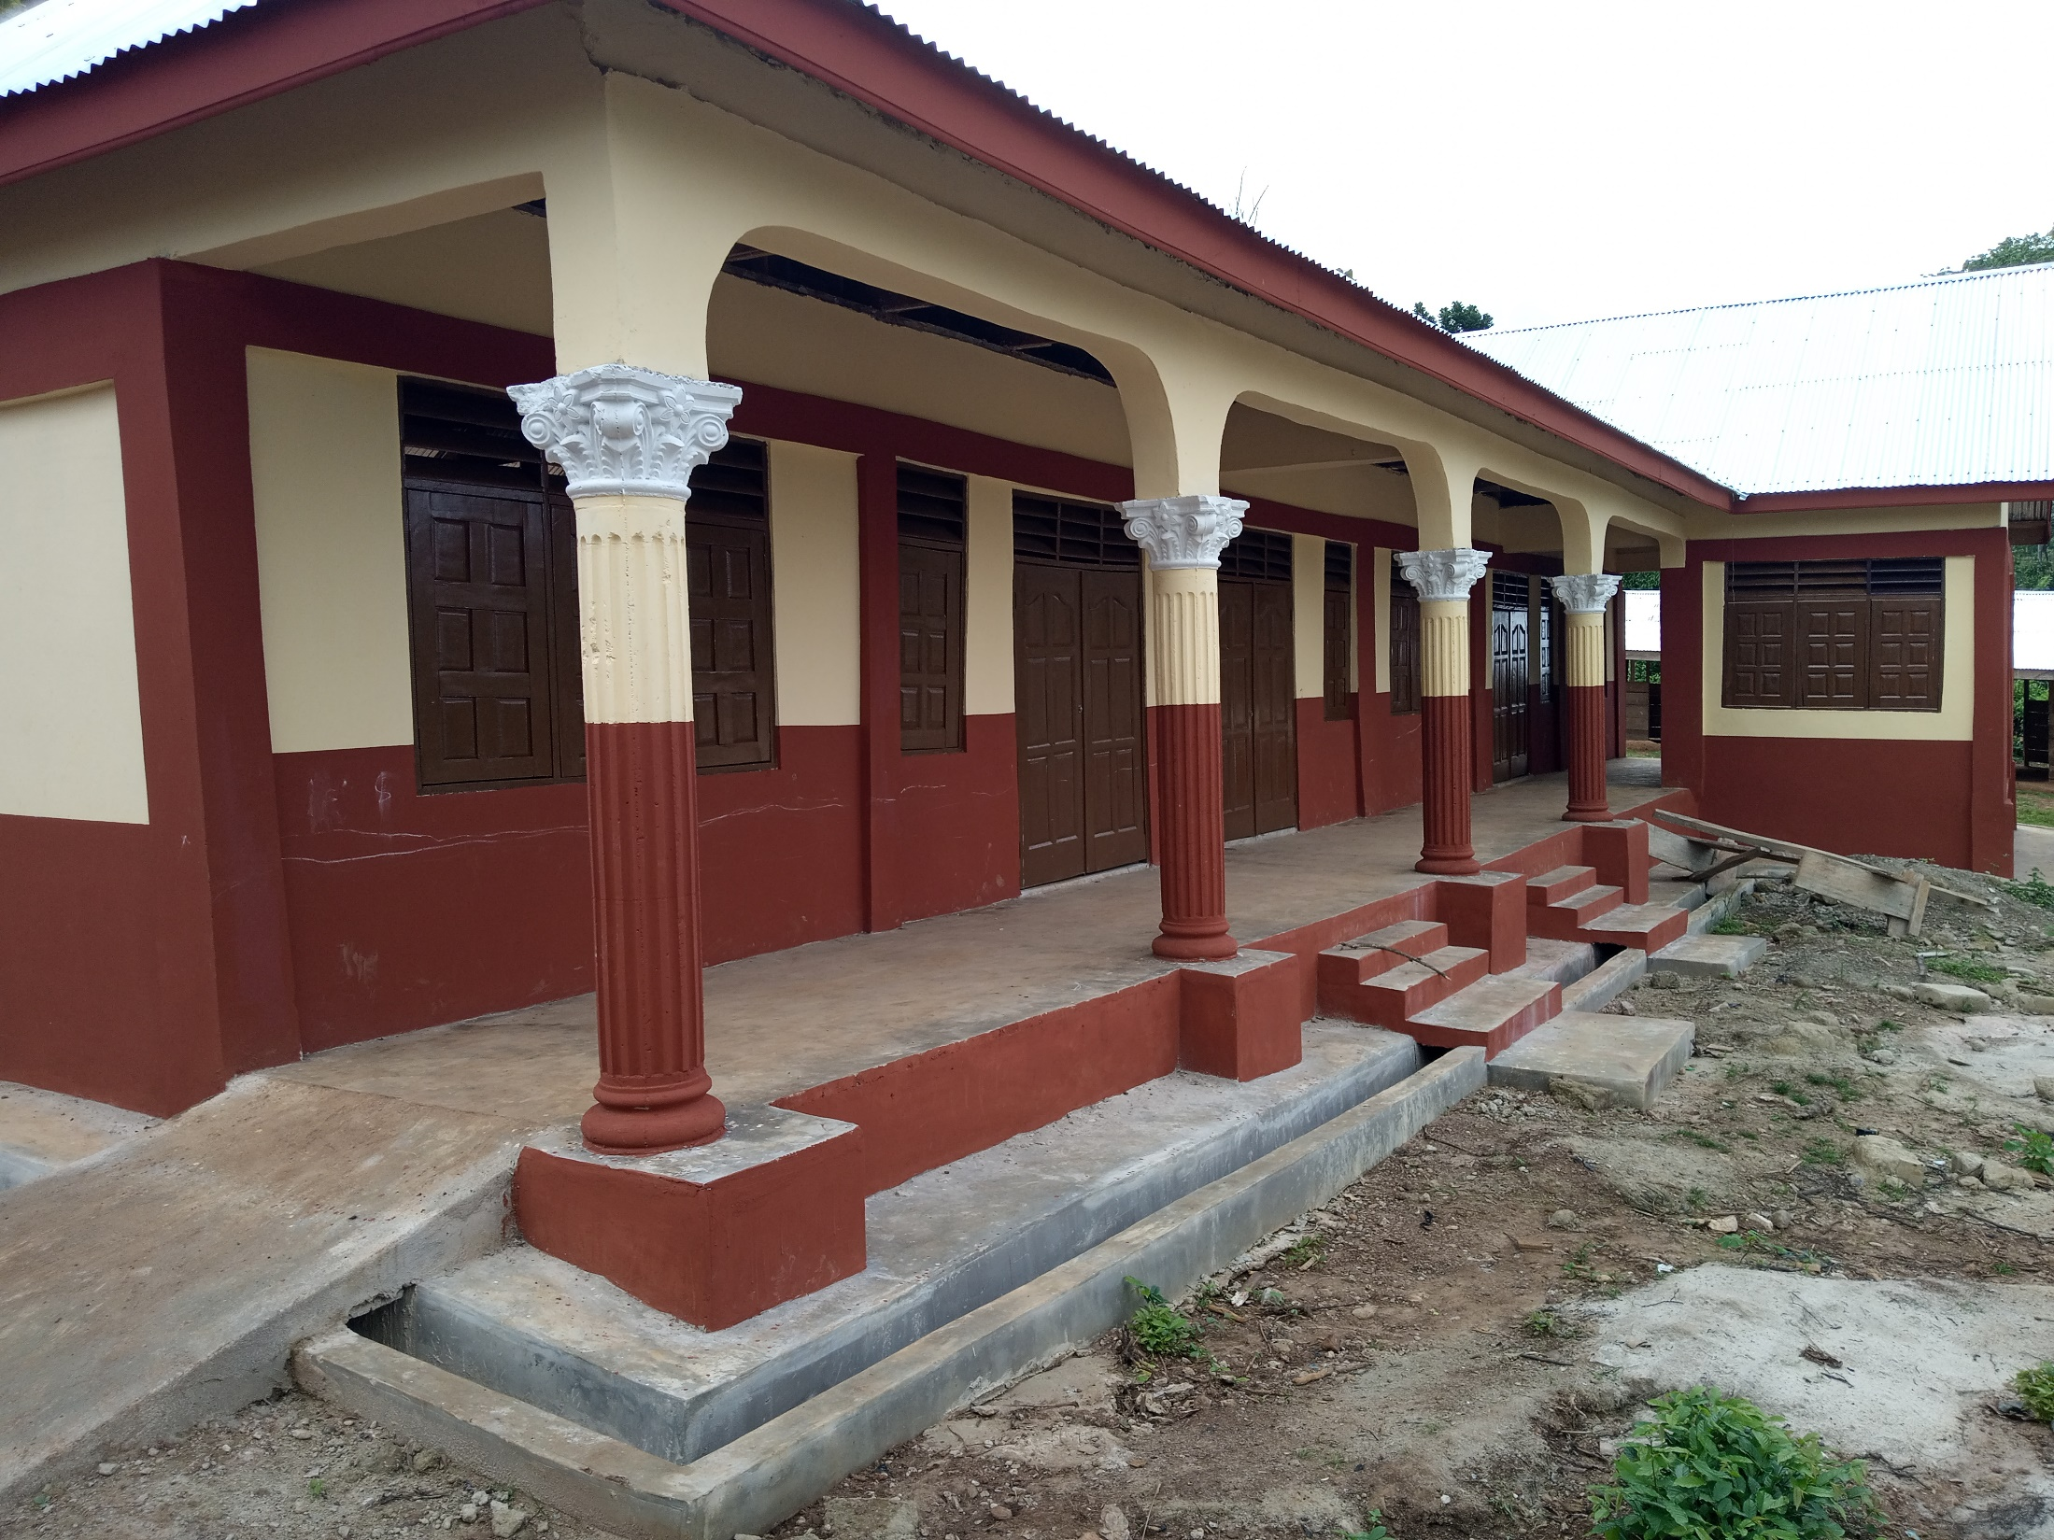
Construction of 3 Unit classroom block at Brekrom

Slide 16
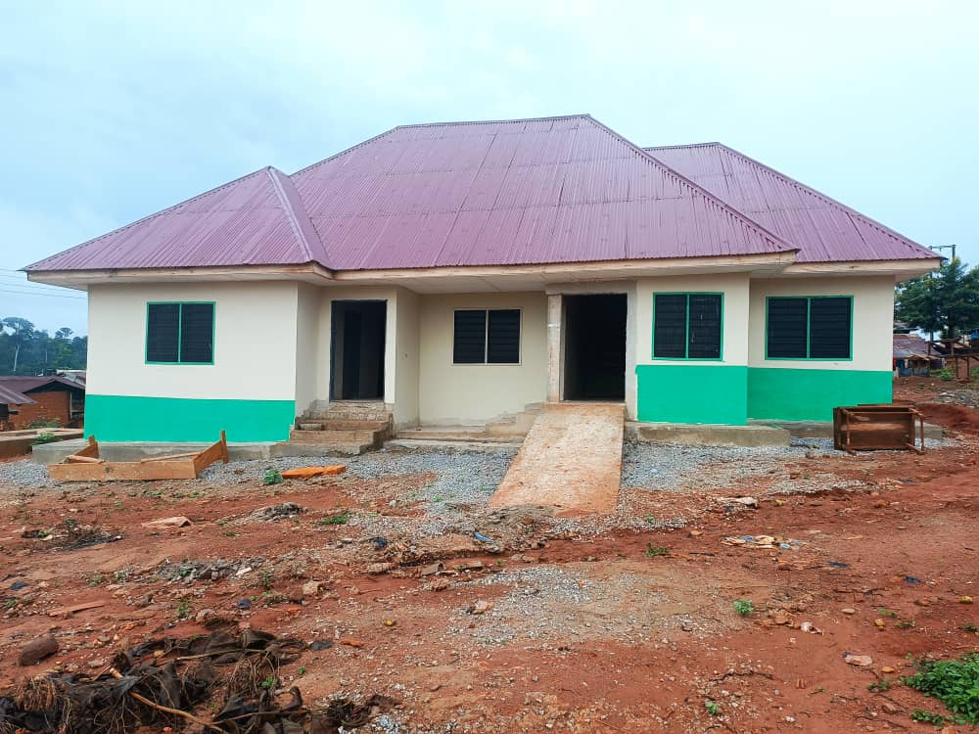
Construction of 1No. CHPS at Juaboso Nkwanta

Slide 17
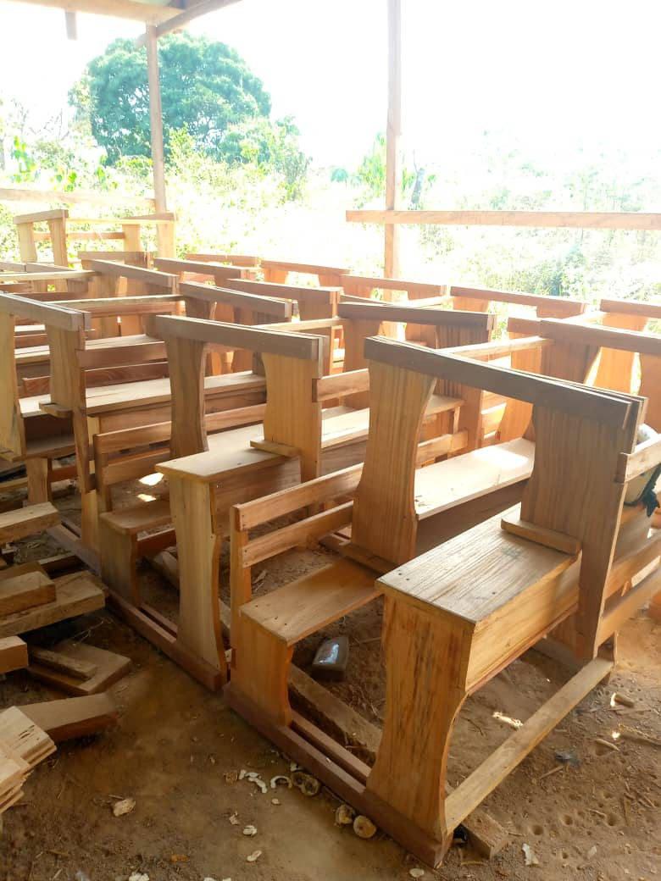
SUPPLY OF DUAL DESK TO SELECTED SCHOOL

Slide 18
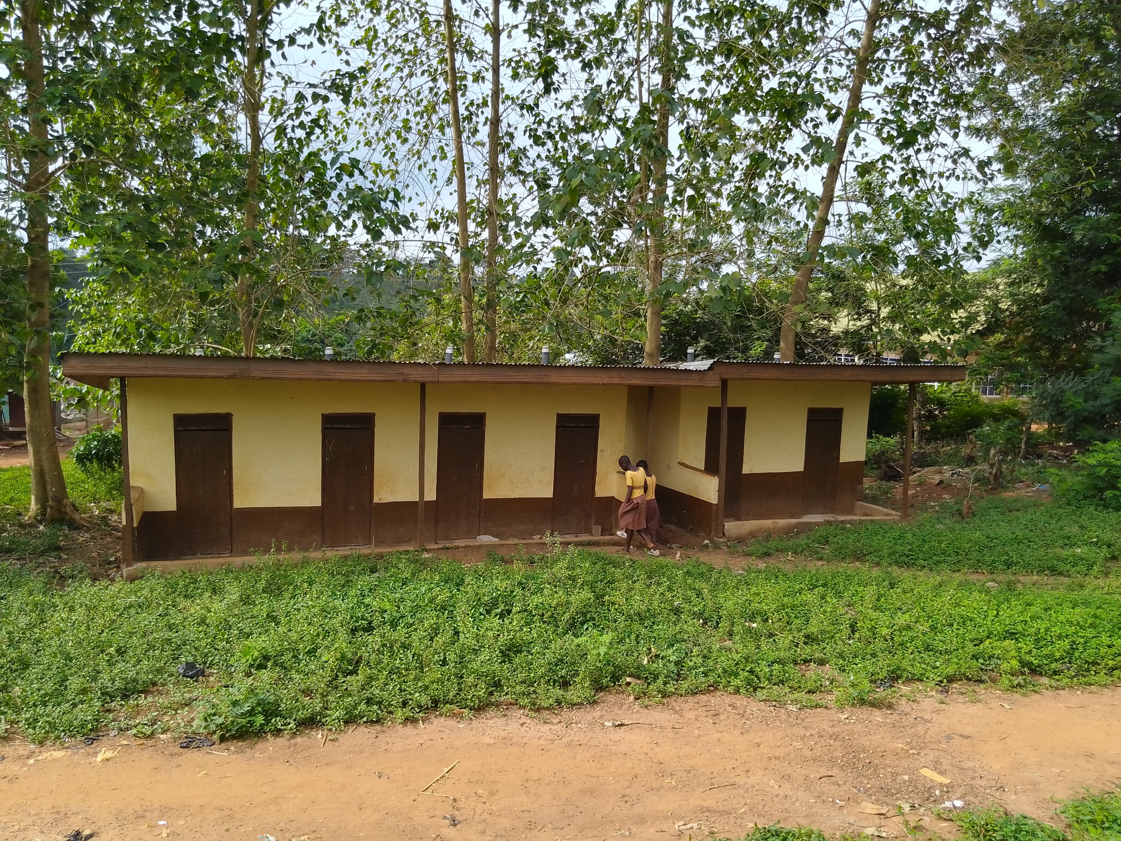
Const. of 1No. 6 Seater VIP Toilet at Juaboso Cluster of Schools

Slide 19
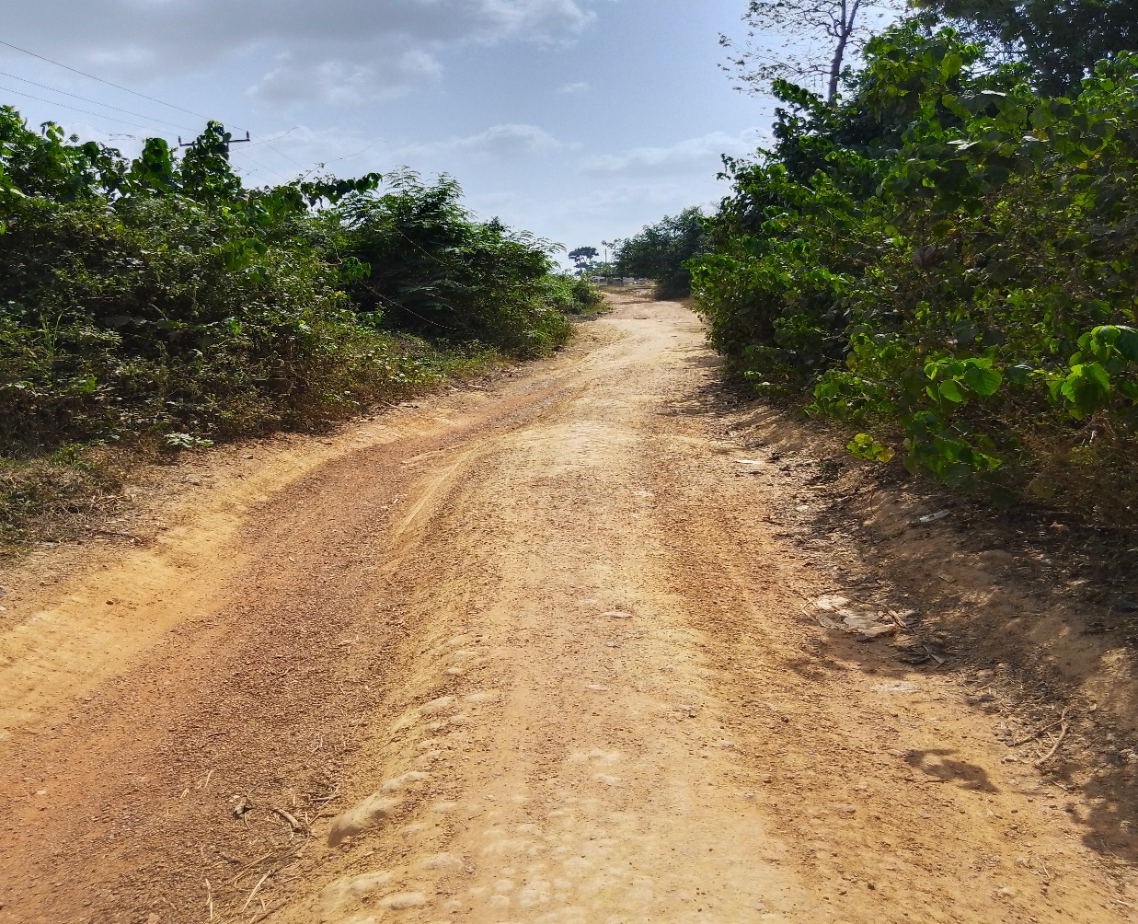
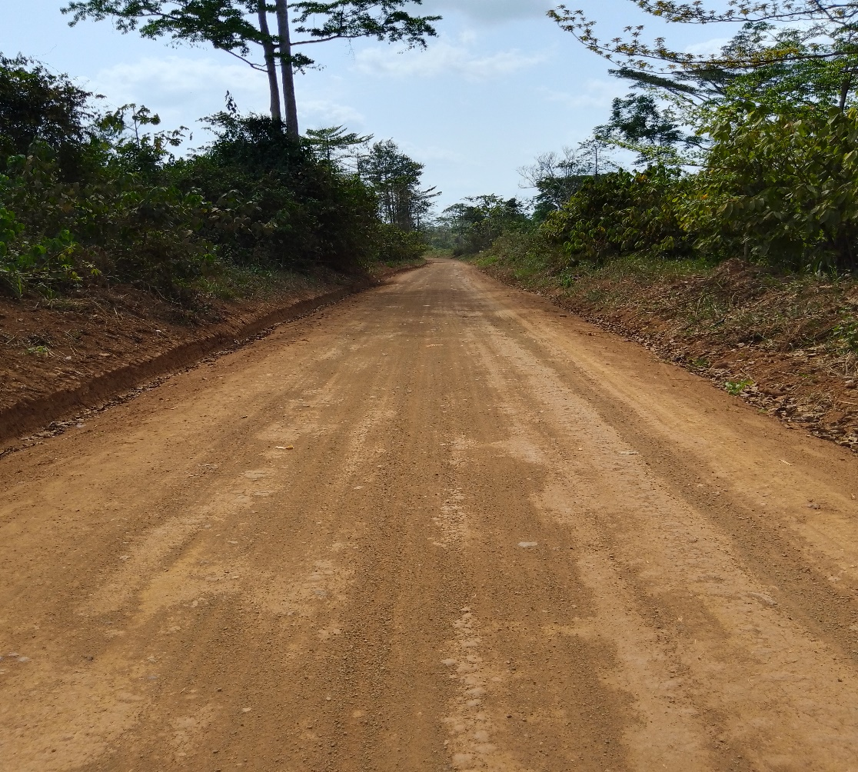
Reshaping of Krokosua to Asempaneye Feeder Road
BEFORE
AFTER

Slide 20
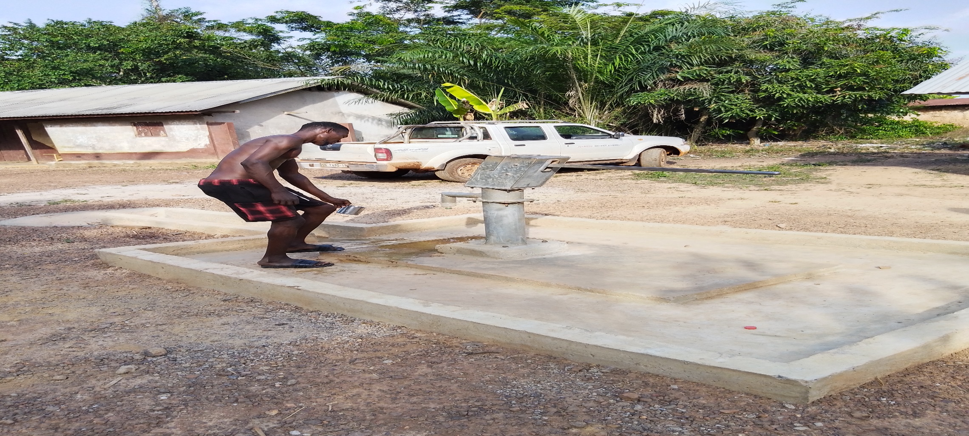
Drilled Borehole fitted with Pump at Sonka

Slide 21
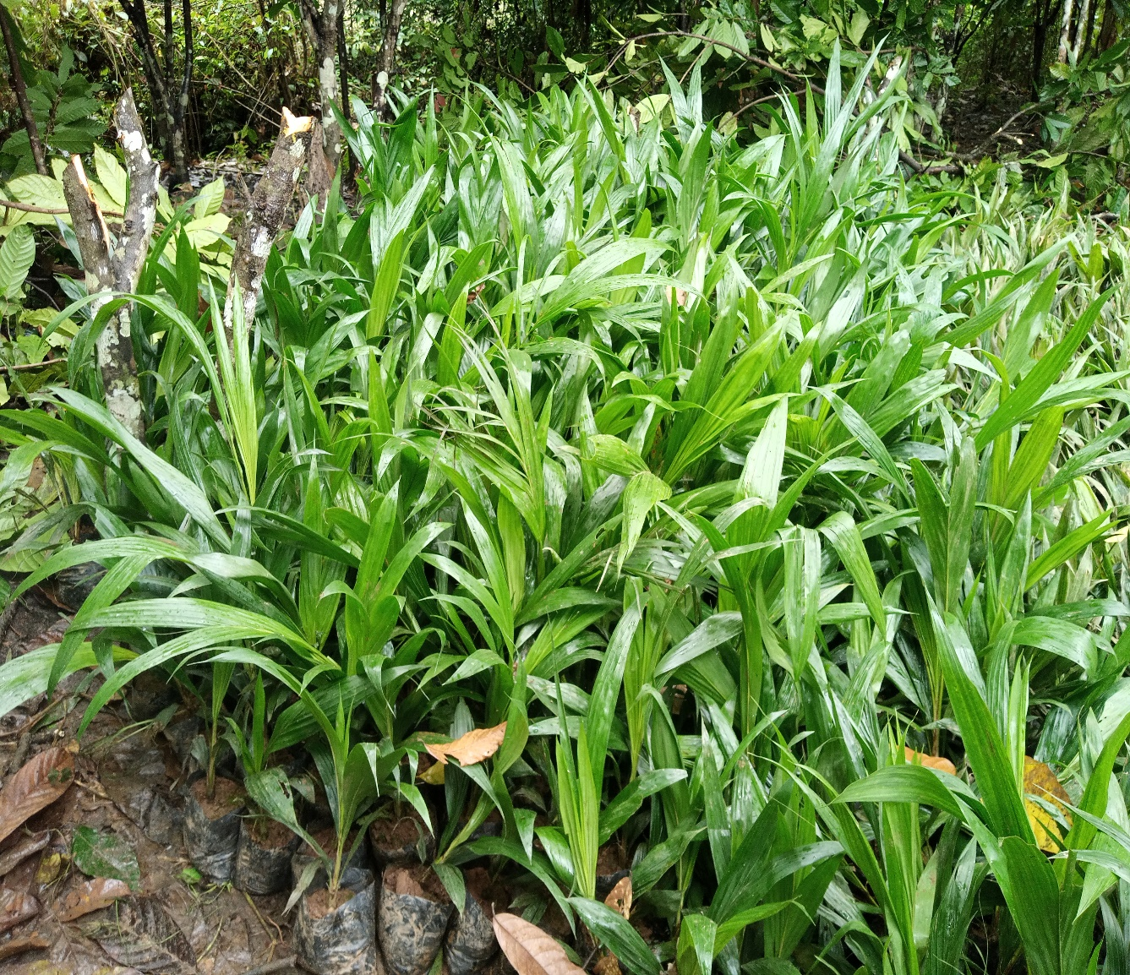
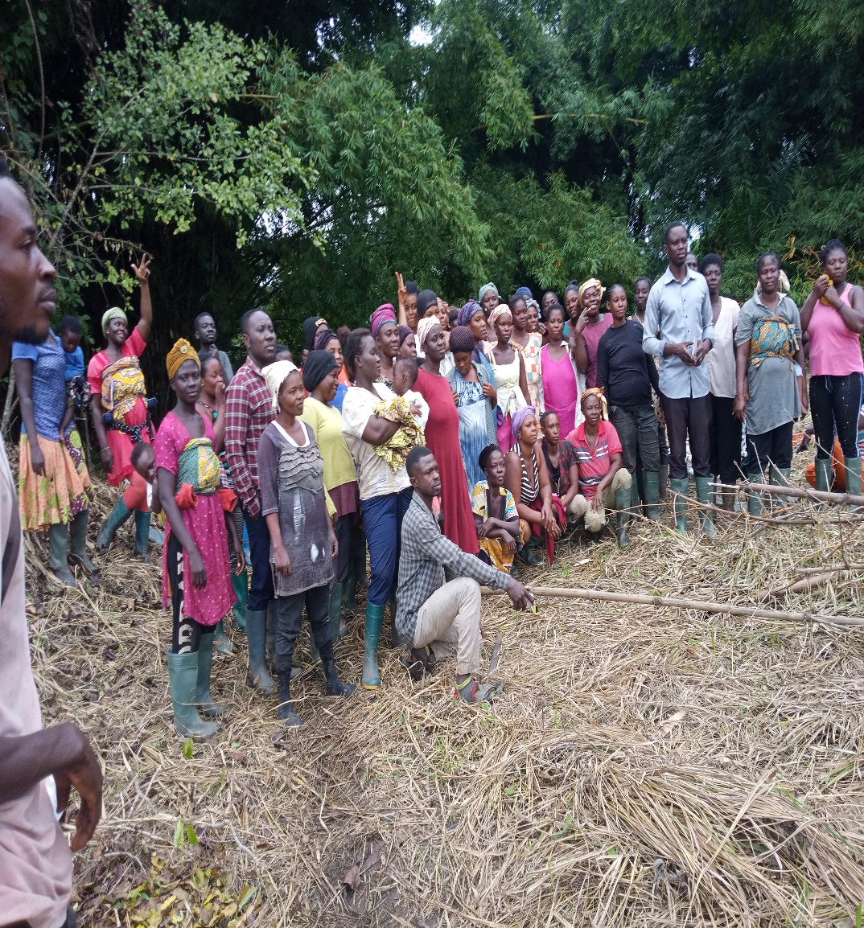
Distribution of palm seedlings to Safety Net Site

Slide 22
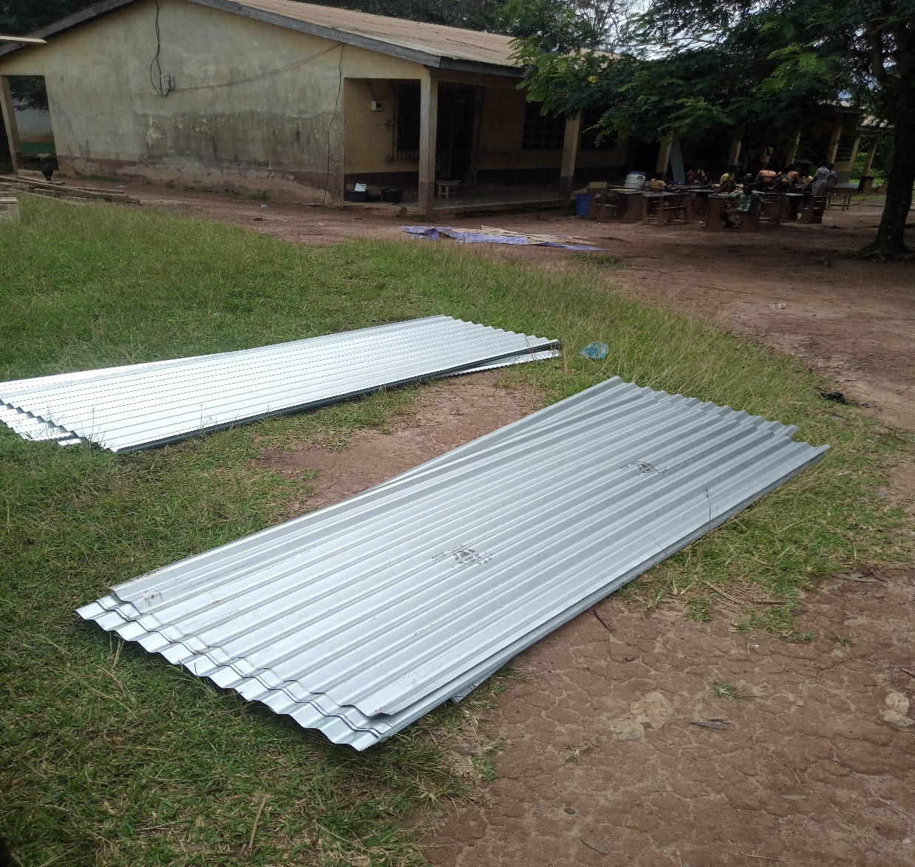
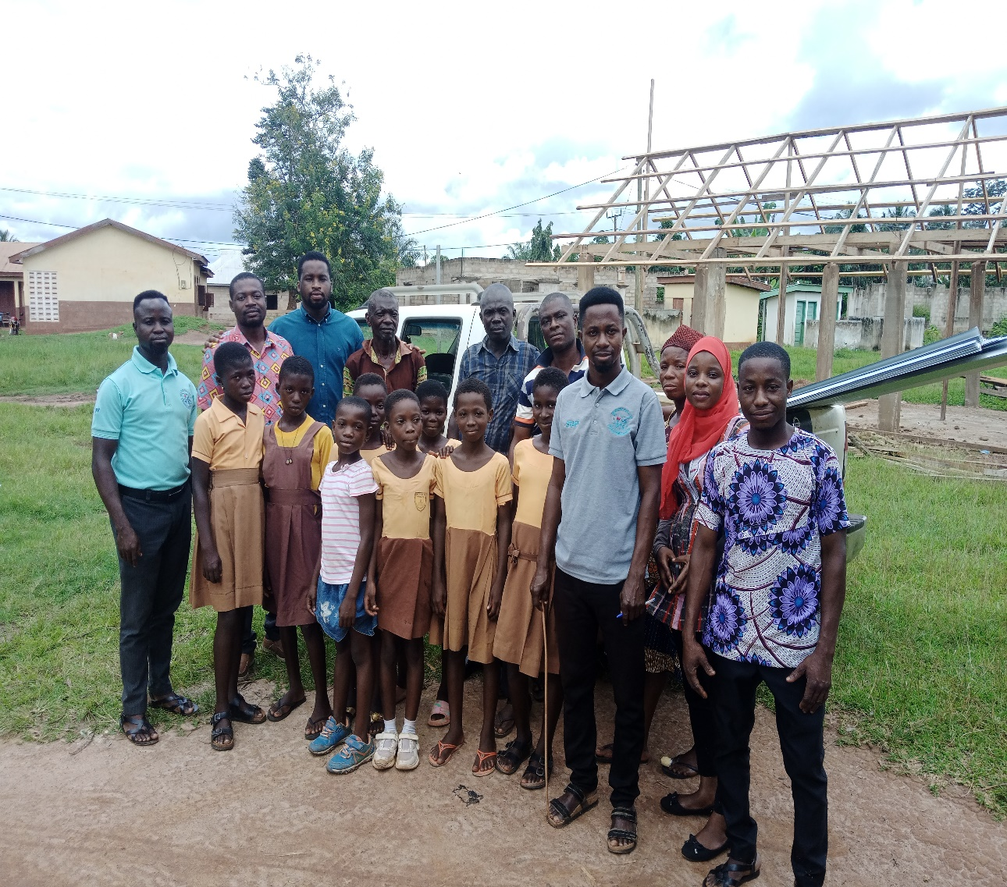
Distribution of roofing sheet to Nkatieso School B

Slide 23
Policy Outcome Indicators and Targets
OUTCOME INDICATOR DESCRIPTION | UNIT OF MEASUREMENT | Previous years performance (2022) |  | Current year’s actual performance (2023)
 |  | Target | Actual | Target | Actual as at August
Improved performance in Education | Percentage Pass in BECE | 95% | 92.4% | 95% | Awaiting
Improved Road Network | No. of Kilometers of roads reshaped | 65km | 30.3km | 34km | 26.4km
Improved Agricultural Productivity | Yield per Hector (maize mt) | 1.87 | 1.86 | 1.90 | -
 | Yield per hectare (rice mt) | 1.88 | 1.86 | 1.92 | -
Improved Sanitation | Total volume of waste disposed | 70mt | 36.19mt | 70mt | 23.14mt
 | Percentage of population with access to proper toilet facilities | 70% | 57.6% | 72% | 60.9%

Slide 24
SANITATION BUDGET PERFORMANCE
LIQUID WASTE
NO. | NAME OF ACTIVITY/PROJECT | BUDGET | ACT. @ AUG 2023
1. | Extension of water to 8-seater WC at District Assembly Office | 35,550.00 | 4,174.00
2. | Construction of Urinal Bay at Proso Market | 77,000.00 | 0.00
SOLID WASTE
1. | Maintenance of Final Disposal Site | 100,000.00 | 24,674.00
2. | Support towards National Sanitation Day | 25,684.40 | 0.00

Slide 25
DP SUPPORTED PEROGAMME (MAG)
NO. | NAME OF ACTIVITY/PROJECT | BUDGET | ACTUAL AS @ AUG 2023
1. | Meetings /seminars | 7,080.00 | 7,080.00
2. | Fuel | 4,000.00 | 4,000.00
3. | Maintenance of Official Vehicle | 7,618.63 | 7,618.63
4. | Monitoring and Evaluation (M&E) | 30,400.00 | 30,400.00
5. | Training Materials | 10,000.00 | 10,000.00
 | Sub- Total | 59,098.63 | 59,098.63

Slide 26
DP SUPPORTED PEROGAMME (SAFETY NET)
NO. | NAME OF ACTIVITY/PROJECT | BUDGET | ACTUAL AS @ AUG 2023
1. | Purchase of Materials and Equipment | 100,000.00 | 30,000.00
2. | Purchase of Fuel and payment of Allowance for M& E Activities | 100,000.00 | 20,000.00
 | TOTAL | 200,000.00 | 50,000.00

Slide 27
GOVERNMENT FLAGSHIP PROJECTS/PROGRAMMES
NO. | NAME OF ACTIVITY/PROJECT | BUDGET | ACTUAL AS@ AUG 2023
1. | Support the implementation of Planting for Food and Jobs programme | 30,000.00 | 20,000.00
2. | Support the implementation of Planting for Export and Rural Development (PERD) | 35,000.00 | 12,000.00

Slide 28
OUTLOOK FOR 2024

Slide 29
JUABOSO ADOPTED POLICY OBJECTIVES FOR 2024
FOCUS AREA | ADOPTED POLICY OBJECTIVES | BUDGET ALLOCATION
LOCAL GOVERNMENCE AND DECENTRALIZATION | Deepen political, financial and administrative decentralization | 1,930,408.50
PUBLIC POLICY MANAGEMENT | Enhance Capacity for policy formulation and Coordination | 2,031,831.00
HEALTH AND HEALTH SERVICE | Ensure accessible, and quality Universal Health Coverage (UHC) for all | 502,189.66
WATER AND SANITATION | Improve access to safe, reliable and sustainable water supply services for all | 830,194.80
EDUCATION AND TRAINING | Enhance equitable access to, and participation in quality education at all levels | 2,447,757.54

Slide 30
JUABOSO ADOPTED POLICY OBJECTIVES FOR 2024
FOCUS AREA | ADOPTED POLICY OBJECTIVES | BUDGET ALLOCATION
TRANSPORT INFRASTRUCTURE | Improve efficiency and effectiveness of road Transport infrastructure and Services | 783,761.54
HUMAN SETTLEMENT AND HOUSING | Promote sustainable, spatially integrated, balanced and orderly development of human settlement | 310,000.00
AGRICULTURE AND RURAL DEVELOPMENT | Modernize and enhance Agricultural Production Systems | 950,603.17
PRIVATE SECTOR DEVELOPMENT | Support entrepreneurs and Local Economic Development | 274,000.00
DISASTER MANAGEMENT | Promote Proactive Planning for disaster prevention and mitigation. | 5,000.00
TOTAL |  | 10,065,746.21

Slide 31
Policy Outcome Indicators and Targets
Outcome Indicator Description | Unit of Measurement | Previous year (2022) |  | Current year (2023) |  | Budget year (2024) | Indicative year (2025) | Indicative year (2026) | Indicative year (2027)
 |  | Target | Actual | Target | Actual as at August | Target | Target | Target | Target
Improved Sanitation Management | Total Volume of waste disposed | 70mt | 36.19mt | 70mt | 23.14mt | 70mt | 70mt | 70mt | 70mt
 | Percentage of population with access to proper toilet facilities | 70% | 57.6% | 72% | 60.9% | 70% | 70% | 70% | 70%
Improved road networks | No. of kilometers of road reshaped | 65km | 30.3km | 64km | 26.4km | 65km | 65km | 65km | 65km
Improved Agricultural Productivity | Yield Per Hector(maize) | 1.87 | 1.86 | 1.90 | - | 1.92 | 1.94 | 1.96 | 1.98
 | Yield per Hector (rice) | 1.88 | 1.86 | 1.92 | - | 1.94 | 1.96 | 1.98 | 2.00
Improved performance in Education | Percentage Pass in BECE | 95% | 92.4% | 95% | Awaiting | 95% | 95% | 95% | 95%

Slide 32
2024-2027 REVENUE PROJECTIONS- IGF ONLY
ITEM | 2023 |  | 2024 | 2025 | 2026 | 2027
 | BUDGET | ACTUAL AS @ AUG | PROJECTION | PROJECTION | PROJECTION | PROJECTION
PROPERTY RATE | 89,000.00 | 76,000.00 | 95,000.00 | 104,500.00 | 111,815.00 | 117,405.75
BASIC RATE | 1,000.00 | 308.00 | 2,000.00 | 2,200.00 | 2,354.00 | 2,471.70
FEES | 150,000.00 | 98,081.00 | 170,000.00 | 187,000.00 | 200,090.00 | 210,094.50
FINES | 12,000.00 | 7,370.00 | 14,000.00 | 15,400.00 | 16,478.00 | 17,301.90
LICENCE | 340,000.00 | 224,334.47 | 374,000.00 | 411,400.00 | 440,198.00 | 462,207.90
LAND | 62,000.00 | 32,172.75 | 70,000.00 | 77,000.00 | 82,390.00 | 86,509.50
RENT | 90,000.00 | 43,847.24 | 95,000.00 | 104,500.00 | 105,930.00 | 111,226.50
MISC. | - | -
SUB-TOTAL | 744,000.00 | 482,113.46 | 820,000.00 | 902,000.00 | 965,140.00 | 1,013,397.00
STOOLLANDS | 450,000.00 | 236,999.52 | 200,000.00 | 495,000.00 | 529,650.00 | 556,132.50
TOTAL | 1,194,000.00 | 719,112.98 | 1,020,000.00 | 1,397,000.00 | 1,494,790.00 | 1,569,529.50

Slide 33
2024-2027 REVENUE PROJECTIONS- ALL FUNDING SOURCES
 | 2023 |  | 2024 | 2025 | 2026 | 2027
 | BUDGET | ACTUAL AS @ AUG | PROJECTION | PROJECTION | PROJECTION | PROJECTION
IGF | 744,000.00 | 482,113.46 | 820,000.00 | 902,000.00 | 965,140.00 | 1,013,397.00
COMPENSATION | 3,609,807.40 | 2,623,598.82 | 3,932,178.21 | 4,325,396.03 | 4,628,173.75 | 4,859,582.44
G&S TRANSFER | 56,000.00 | 26,578.75 | 93,500.00 | 102,850.00 | 110,049.50 | 115,551.98
DACF | 2,000,000.00 | 535,235.12 | 2,500,000.00 | 2,750,000.00 | 2,942,500.00 | 3,089,625.00
DDF | 1,164,502.04 | - | 1,420,068.00 | 1,562,074.80 | 1,671,420.04 | 1,754,991.04
MAG | 59,098.63 | 59,098.63 |  | - | - | -
MP'S CF | 490,000.00 | 398,362.66 | 600,000.00 | 660,000.00 | 706,200.00 | 741,510.00
STOOLLAND | 450,000.00 | 236,999.52 | 200,000.00 | 495,000.00 | 529,650.00 | 556,132.50
PWD | 100,000.00 | 48,246.48 | 200,000.00 | 220,000.00 | 235,400.00 | 247,170.00
Safety Net | 200,000.00 | 50,000.00 | 200,000.00 | 220,000.00 | 235,400.00 | 247,170.00
Carbon Credit | 59,098.63 | 94,186.85 | 100,000.00 | 110,000.00 | 117,700.00 | 123,585.00
TOTAL | 8,932,506.70 | 4,554,420.29 | 10,065,746.21 | 11,347,320.83 | 12,141,633.29 | 12,748,714.95

Slide 34
EXPENDITURE BY BUDGET PROGRAMME AND ECONOMIC CLASSIFICATION –ALL FUNDING SOURCES
BUDGET PROGRAMME | AMOUNT GH
 | COMPENSATION OF EMPLOYEES | GOODS AND SERVICE | CAPITAL EXPENDITURE | TOTAL
MANAGEMENT AND ADMINISTRATION | 3,058,958.71 | 1,476,500.00 | - | 4,285,458.71
SOCIAL SERVICE DELIVERY | 143,228.60 | 1,132,500.00 | 1,477,447.20 | 2,753,175.80
INFRASTRUCTURE DELIVERY | 321,887.73 | 468,000.00 | 1,111,620.80 | 1,901,508.53
ECONOMIC DEVELOPMENT | 578,103.17 | 542,500.00 | - | 1,120,603.17
ENVIRONMENTAL MANAGEMENT |  | 5,000.00 | - | 5,000.00
TOTAL | 4,102,178.21 | 3,624,500.00 | 2,589,068.00 | 10,065,746.21

Slide 35
GOVERNMENT FLAGSHIP PROJECTS/PROGRAMMES FOR 2024
NO. | NAME OF ACTIVITY/PROJECT | BUDGET | FUNDING SOURCE
1. | Support the implementation of Planting for Food and Jobs programme | 30,000.00 | DACF
2. | Support for Planting for Export and Rural Development | 35,500.00 | DACF

Slide 36
KEY PROJECTS FOR 2024 AND THEIR CORRESPONDING COST AND JUSTIFICATION
LIST OF ALL PROJECTS | IGF | GOG | DACF | DACF-RFG | MP | STOOLLAN. | UNICEF | MAG | SAFETY | TOTAL | JUSTIFICATION
Construction of 1no. 4 unit Nurses Quarters at Bonsu Nkwanta |  |  | 50,000.00 |  |  |  |  |  |  |  | To provide shelter for staff’s who live far away from the District
Const. of 6no. Boreholes at Onyinakrom, Asoredanho, Yiemfo,Pusi,Ensonyameye,Camp 5 |  |  | 20,194.80 |  |  |  |  |  |  |  | To help provide safe water to people in the District
Renovation of 1No. 6unit Classroom Block with Ancillary Facilities at Sayerano |  |  | 115,757.07 |  |  |  |  |  |  |  | To ensure quality teaching and learning
Const. of 1 no. 6 unit Classroom Block with Ancillary facilities at Yawagyiemkrom |  |  | 83,703.94 |  |  |  |  |  |  |  | To ensure quality teaching and learning
Const. of 1no. 3 unit Classroom Block, 3 Seater KVIP and 3 Urinal at Danyame |  |  | 31,053.01 |  |  |  |  |  |  |  | To ensure quality teaching and learning
Completion of 1no. 6 units Classroom block with office and store at Eteso |  |  | 46,973.25 |  |  |  |  |  |  |  | To ensure quality teaching and learning
Construction of 1no. 2unit KG Block with office and restroom at Juaboso |  |  |  | 300,000.00 |  |  |  |  |  |  | To help provide quality teaching and learning
Construction of 1no. 2unit KG Block with office and restroom at Bonsu Nkwanta |  |  |  | 300,000.00 |  |  |  |  |  |  | To help provide quality teaching and learning

Slide 37
SANITATION BUDGET
LIQUID WASTE
1. | Construction of 1no. 3 Seater KVIP and 3 Urinal at Danyame | 31,053.01
SOLID WASTE
1. | Maintenance of Final Disposal Site | 100,000.00
2. | Purchase of Sanitation Equipment | 20,000.00
3 | Support toward National Sanitation Day | 40,000.00
4. | Provision for Fumigation/SIP | 350,000.00

Slide 38
DONOR PARTNER (DP) SUPPORT PROGRAMME(CARBON CREDIT
NO. | NAME OF ACTIVITY/PROJECT | BUDGET
1. | Public Education | 20,000.00
2. | Tree Planting (Afforestation | 40,000.00
3. | Climate Change mitigation measures | 20,000.00
4. | Monitoring and evaluation | 20,000.00
 | Total | 100,000.00

Slide 39
DONOR PARTNER (DP) SUPPORT PROGRAMME (SAFETY NET)
NO. | NAME OF ACTIVITY/PROJECT | BUDGET
1. | Purchase of Materials and Equipment | 120,000.00
2. | Purchase of Fuel and payment of Allowance for M& E Activities | 80,000.00
 | TOTAL | 200,000.00

Slide 40
JUABOSO – COMPENSATION OF EMPLOYEES
NO. | DEPARTMENT | STAFF STRENGTH | MONTHLY SALARY | ANNUAL SALARY
1. | CENTRAL ADMINISTRATION | 72 | 211,996.54 | 2,543,958.43
2. | FINANCE | 5 | 12,129.32 | 145,551.80
3. | WORKS DEPARTMENT | 6 | 23,027.96 | 276,335.54
4. | SOCIAL WELFARE AND COMMUNITY DEV’T | 3 | 11,935.72 | 143,228.60
5. | AGRIC. DEPT. | 12 | 48,175.26 | 578,103.17
6. | STATISTICS | 3 | 11,649.49 | 139,793.82
7. | HUMAN RESOUCE | 1 | 4,971.22 | 59,654.66
8. | PHYSICAL PLANNING | 1 | 3,796.02 | 45,552.19
 | TOTAL | 103 | 327,681.52 | 3,932,178.21

Slide 41
JUABOSO – COMPENSATION OF CASUAL (IGF) STAFF
NO. | DEPARTMENT | STAFF STRENGTH | MONTHLY SALARY | ANNUAL SALARY
1. | CENTRAL ADMINISTRATION | 15 | 7,970.00 | 95,640.00
 | TOTAL | 15 | 7,970.00 | 95,640.00
 | GRAND TOTAL | 118 | 335,651.52 | 4,027,818.21

Slide 42
THANK YOU
© 2018. All rights reserved. No part of this publication may be stored in a retrieval system or
transmitted in any or by any means, electronic, mechanical, photocopying, recording or otherwise without the prior
written permission of the Ministry of Finance

