Slide 1


JUABOSO DISTRICT ASSEMBLY
2025-2028 COMPOSITE BUDGET
PRESENTED BY HON. GODFRED KWABENA AGYEI
DISTRICT CHIEF EXECUTIVE
ON
21ST OCTOBER, 2024

Slide 2
Outline of the Presentation
Introduction
Strategic Overview of the MMDA
Financial Performance – Revenue
- Expenditure
Key Achievements for 2024
2024 Budget Programme Performance
Outlook for 2025-2028

Slide 3
INTRODUCTION
Juaboso District Assembly was established by Legislative Instrument (LI) 2020 in 2012.
District Capital - Sefwi Juaboso
Electoral Areas-16
25 Assembly Members: 7 Government Appointees, 16 Elected, District Chief Executive and Member of Parliament (22 Males and 3 Females)
The District Shares Boundary with Bia West to the north, Asunafo South and sefwi wiawso municipal to the East, Bodi District to the South, La cote D’ivoire and Suaman to the West.
VISION STATEMENT
“To be among the first class Districts in the Country”
MISSION STATEMENT
“Juaboso District Assembly (JDA) exists to raise the living standards of the people through formulation and implementation of policies in partnership with local development stakeholders to improve access to basic services and create opportunities for wealth creation”.
CORE FUNCTIONS
Exercise political and administrative authority in the District.
Promote local economic development.
Exercise deliberative, legislative and executive functions

Slide 4
POPULATION
According to the 2021 Population and Housing Census, the population of the District was 88,814 with more males (45,722) representing 51.5 percent than females (43,092) constituting 48.5 percent. Currently the projected population stands at 94,250 with 48,538 males and 45,712 females. The population projection for 2025 is estimated at 96,135 with 49,510 males and 46,625 females
ECONOMY OF THE DISTRICT
Agriculture is the main economic activity in the District. It employs about 76.2%
15.3% are in craft and other related trades.
8.5% are in services, commerce and trade.
ROADS
There are about 241.5 kms of engineered roads in the District.
78.5 kms of this road are tarred and 163kms untarred.
EDUCATION:
Juaboso District has Nine (9) educational circuits.
295 Schools (108 KGs, 110 Primary Sch. and 75 JHS)
One (1) public and one (1)private Senior High Schools.
Gross Enrolment rate stands at 158.4% with 154.7% for males and 162.2% for females
Gender Parity Index (GPI) on GER stands at 0.98%

Slide 5
INTRODUCTION
HEALTH:
One (1) Government Hospital, One (1) Private Hospital, Two (2) Health Centers, Eight (8) Maternity homes
Thirty six (36 ) CHPS compounds.
The Doctor patient ratio stands at 1:23,710
SANITATION:
About 52.5% of households dispose their solid waste at approved dumping sites and 47.5% dump indiscriminately
44.3% have access to the toilet facilities in their houses, whiles 11.2% shares the facility with them and 44.5% do practice open defecation
TOURISM:
The district has a number of tourist sites such as Big Rock (NyoboePiri), Bodan rock, Alekabuma (box rock), Elephant sanctuary, Krokosue Forest Reserve, Boinzan waterfalls and Ahantamoe. However, these sites are yet to be developed.

Slide 6
KEY CHALLENGES/ISSUES
1. | Deplorable nature of Feeder roads.
2. | Inadequate Potable water facilities.
3. | Inadequate Market facilities.
4. | Inadequate Educational and Health Facilities.
5. | Insufficient Agric Extension officers
6. | Inadequate Sanitation Facilities (Zoomlion Containers)
7. | Inadequate Drainage system

Slide 7
 | ADOPTED POLICY OBJECTIVES
 | Deepen political, financial and administrative decentralization
 | Enhance Capacity for policy formulation and Coordination
 | Enhance equitable access to, and participation in quality education at all levels
 | Ensure accessible, and quality Universal Health Coverage (UHC) for all
 | Improve access to safe and reliable water supply services for all
 | Improve efficiency and effectiveness of road Transport Infrastructure and Service
 | Modernize and enhance Agricultural Production System.
 | Support Entrepreneurs and Local Economic Development.
 | Promote sustainable, spatially integrated, balanced and orderly development of human settlement

Slide 8
FINANCIAL PERFORMANCE-REVENUE
REVENUE PERFORMANCE –IGF ONLY
 | 2022 |  | 2023 |  | 2024 |  | %per. | %per
 | BUDGET | ACTUAL | BUDGET | ACTUAL | BUDGET | ACTUAL @ SEP | A/B*100 | A/STA*100
POPERTY RATE | 152,000.00 | 18,941.81 | 89,000.00 | 76,000.00 | 77,000.00 | 38,830.74 | 50.43 | 7.24
BASIC RATE | 500.00 | 200.00 | 1,000.00 | 308.72 | 1,000.00 | - | - | -
FEES | 152,400.00 | 146,083.62 | 150,000.00 | 148,606.00 | 170,000.00 | 143,872.00 | 84.63 | 26.81
FINES | 12,000.00 | 11,520.00 | 12,000.00 | 14,789.00 | 14,000.00 | 13,189.00 | 94.21 | 2.46
LICENCE | 311,900.00 | 345,722.71 | 340,000.00 | 354,141.73 | 300,000.00 | 252,382.88 | 84.13 | 47.03
LAND | 62,200.00 | 31,890.00 | 62,000.00 | 33,354.80 | 60,000.00 | 31,940.00 | 53.23 | 5.95
RENT | 87,800.00 | 51,897.06 | 90,000.00 | 55,232.77 | 95,000.00 | 56,411.64 | 59.38 | 10.51
SUB-TOTAL | 778,800.00 | 606,255.20 | 744,000.00 | 682,433.02 | 717,000.00 | 536,626.26 | 74.84 | 100.00
STOOLLANDS | 450,000.00 | 333,305.00 | 450,000.00 | 313,700.31 | 700,000.00 | 301,837.00 | 43.12
GRAND TOTAL | 1,228,800.00 | 939,560.20 | 1,194,000.00 | 996,133.33 | 1,417,000.00 | 838,463.26 | 59.17

Slide 9
FINANCIAL PERFORMANCE-REVENUE
REVENUE PERFORMANCE –ALL REVENUE SOURCES
ITEMS | 2022 |  | 2023 |  | 2024 |  | % PERFORM
 | BUDGET | ACTUAL | BUDGET | ACTUAL | BUDGET | ACTUAL @ SEP
IGF | 1,228,800.00 | 939,560.20 | 1,194,000.00 | 996,133.33 | 1,417,000.00 | 838,463.26 | 59.17
COMPEN.TRAN. | 2,355,185.00 | 2,604,375.62 | 4,017,671.14 | 4,017,671.14 | 5,167,968.47 | 3,911,433.00 | 75.69
G&S TRANSFER | 101,865.00 | 101,865.00 | 56,000.00 | 38,300.21 | 93,500.00 | - | -
DACF | 3,377,394.11 | 788,511.46 | 2,000,000.00 | 1,094,788.58 | 3,686,609.00 | 552,246.34 | 14.98
DACF-RFG | 1,164,502.04 | 1,164,502.40 | 1,164,502.04 | 50,000.00 | 2,902,699.00 | 1,837,631.00 | 63.31
MP'S CF | 340,000.00 | 378,889.98 | 490,000.00 | 476,544.89 | 1,210,000.00 | 649,214.41 | 53.65
MAG | 82,502.00 | 82,501.59 | 59,098.63 | 59,098.63 | - | - | -
SAFETY NET |  |  | 800,000.00 | 792,210.00 | 650,000.00 | - | -
PWD |  |  | 100,000.00 |  | 200,000.00 | 153,696.70 | 76.85
CARBON CREDIT |  |  | 100,000.00 | 94,186.85 | 200,000.00 | - | -
TOTAL | 8,650,248.15 | 6,060,206.25 | 9,981,271.81 | 7,618,933.63 | 15,527,776.47 | 7,942,684.71 | 51.15

Slide 10
FINANCIAL PERFORMANCE - EXPENDITURE
EXPENDITURE PERFORMANCE (ALL DEPARTMENTS) IGF ONLY
EXPENDITURE | 2022 |  | 2023 |  | 2024
 | BUDGET | ACTUAL | BUDGET | ACTUAL | BUDGET | ACT. @ SEP | % PERFORM
COMPENSATION | 154,401.19 | 143,264.82 | 117,801.00 | 103,445.89 | 170,000.00 | 48,290.24 | 28.41
GOODS&SERVICE | 468,638.81 | 368,626.38 | 477,399.00 | 457,533.78 | 403,600.00 | 458,748.37 | 113.66
ASSETS | 155,760.00 | 94,364.00 | 148,800.00 | 121,453.35 | 143,400.00 | 29,587.65 | 20.63
TOTAL | 778,800.00 | 606,255.20 | 744,000.00 | 682,433.02 | 717,000.00 | 536,626.26 | 74.84

Slide 11
FINANCIAL PERFORMANCE-EXPENDITURE
EXPENDITURE PERFORMANCE (ALL DEPARTMENTS) ALL FUNDING SOURCES
EXPENDITURE | 2022 |  | 2023 |  | 2024
 | BUDGET | ACTUAL | BUDGET | ACTUAL | BUDGET | ACT @ SEP | % PERFORM.
COMPENSATION | 2,368,856.19 | 2,807,268.97 | 4,178,272.14 | 4,189,217.61 | 5,337,968.47 | 3,996,282.88 | 74.87
GOODS&SERVICE | 3,017,203.00 | 2,103,308.88 | 3,353,440.42 | 2,118,299.31 | 6,033,109.00 | 2,517,409.69 | 41.73
ASSETS | 3,264,188.96 | 1,149,628.40 | 2,449,559.25 | 1,311,416.71 | 4,156,699.00 | 577,067.11 | 13.88
TOTAL | 8,650,248.15 | 6,060,206.25 | 9,981,271.81 | 7,618,933.63 | 15,527,776.47 | 7,090,759.68 | 45.67

Slide 12
EXPENDITURE BY BUDGET PROGRAMME AND ECONOMIC CLASSIFICATION –ALL FUNDING SOURCES
BUDGET PROGRAMME | AMOUNT GH¢
 | BUDGET | COMPENSATION OF EMPLOYEES | GOODS & SERVICE | CAPITAL EXPENDITURE | TOTAL
Management and Administration | 6,697,817.92 | 2,854,545.57 | 1,984,594.84 | - | 4,839,140.41
Social Services Delivery | 4,709,982.81 | 172,052.06 | 390,789.00 | 394,250.00 | 957,091.06
Infrastructure Delivery and Management | 1,504,659.73 | 433,649.55 | 61,155.54 | - | 494,805.09
Economic Development | 2,591,316.01 | 536,035.70 | 70,260.31 | 182,817.11 | 789,113.12
Environmental Management | 24,000.00 | - | 10,610.00 | - | 10,610.00
TOTAL | 15,527,776.47 | 3,996,282.88 | 2,517,409.69 | 577,067.11 | 7,090,759.68

Slide 13
FINANCIALS 2024 KEY PROJECTS AND PROGRAMMES FROM ALL SOURCES
NO. | NAME OF PROJECT | AMOUNT BUDGETED | ACT. PAYMENT @ SEP, 2024 | OUTSTANDING PAYMENT
1. | Completion of security post at Juaboso-Nkwanta to Benchemaa Road | 80,000.00 | 80,000.00 | 0.00
2. | Renovation of 1No. 6 Unit Classroom at Sayerano | 304,695.00 | 90,000.00 | 214,695.00
3. | Provision for My First Day at School | 10,000.00 | 10,000.00 | 0.00
4. | Completion of 1No. CHPS Compound at Kefass | 353,523.45 | 200,000.00 | 153,523.45
6. | Organize Independence Day Celebration | 80,000.00 | 80,000.00 | 0.00
7. | Support to DPCU activities (Monitoring & Evaluation) | 10,000.00 | 8,000.00 | 2,000.00
9. | Renovation of Juaboso Market | 143,300.00 | 92,624.59 | 50,675.41

Slide 14
NON FINANCIAL PERFORMANCE BY PROGRAMMES

Slide 15
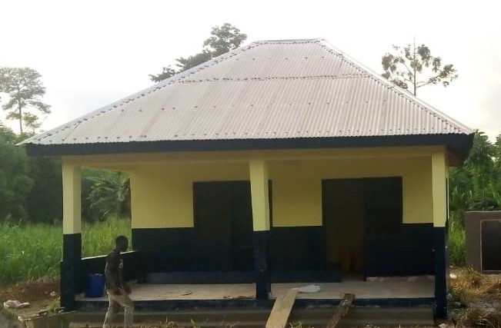
Completion of Security Post at Juaboso-Nkwanta to Benchemaa Barrier

Slide 16
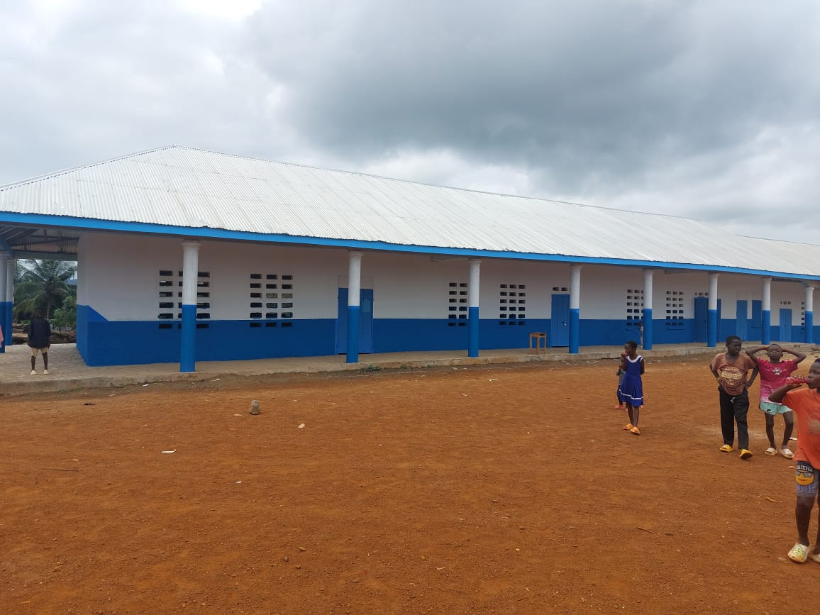
COMPLETION OF 1NO 6UNIT CLASSROOM BLOCK AT SAYERANO

Slide 17
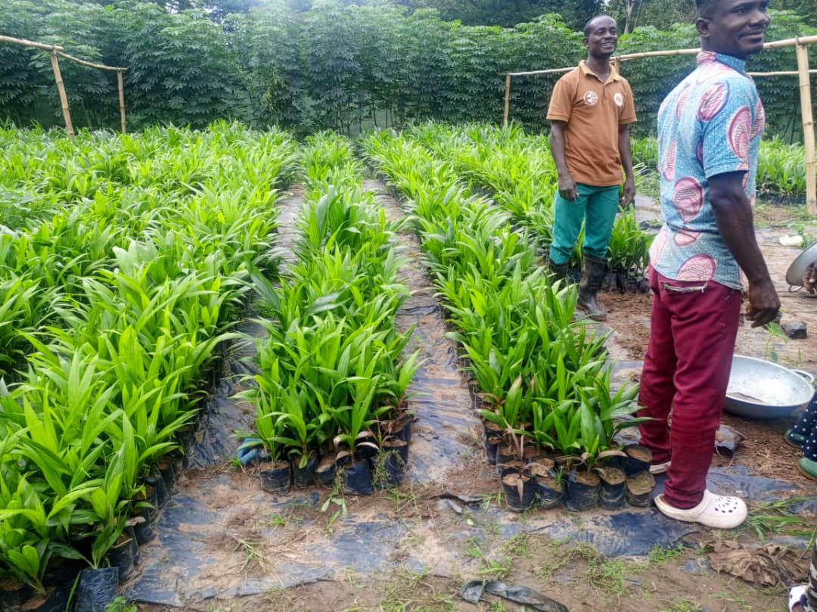
PROCURED AND SUPPLIED 18,000 OIL PALM SEEDLINGS TO BENEFICIARY FARMERS UNDER THE SAFETY NET PROGRAMME

Slide 18
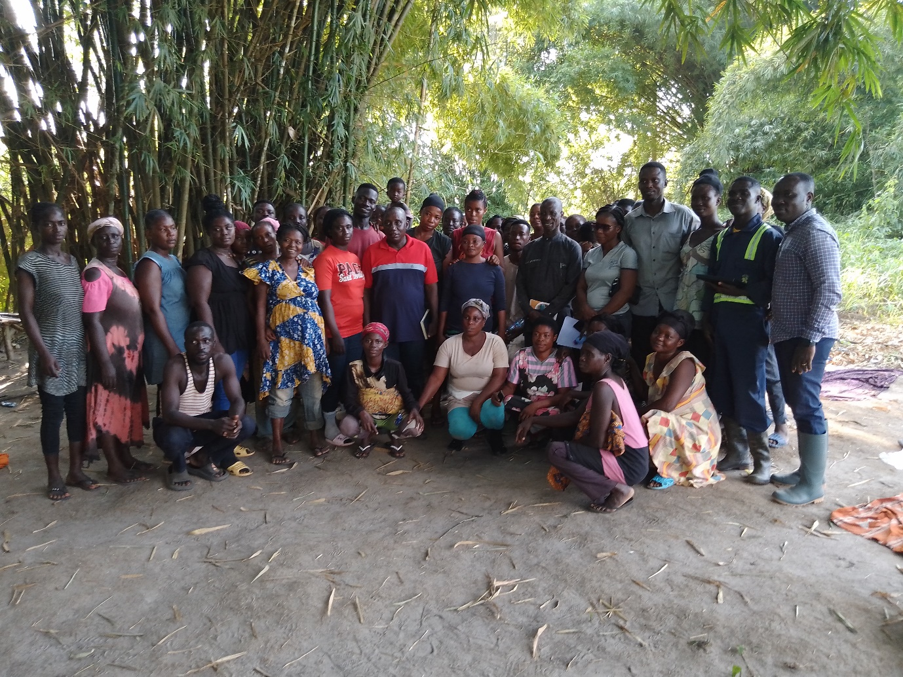
EMPLOYED 175 BENEFICIARIES UNDER GHANA PRODUCTIVE SAFETYNET (II) IN 3 BENEFICIARY COMMUNITIES (SAYERANO, NKATIESO AND JUABOSO NKWANTA)

Slide 19
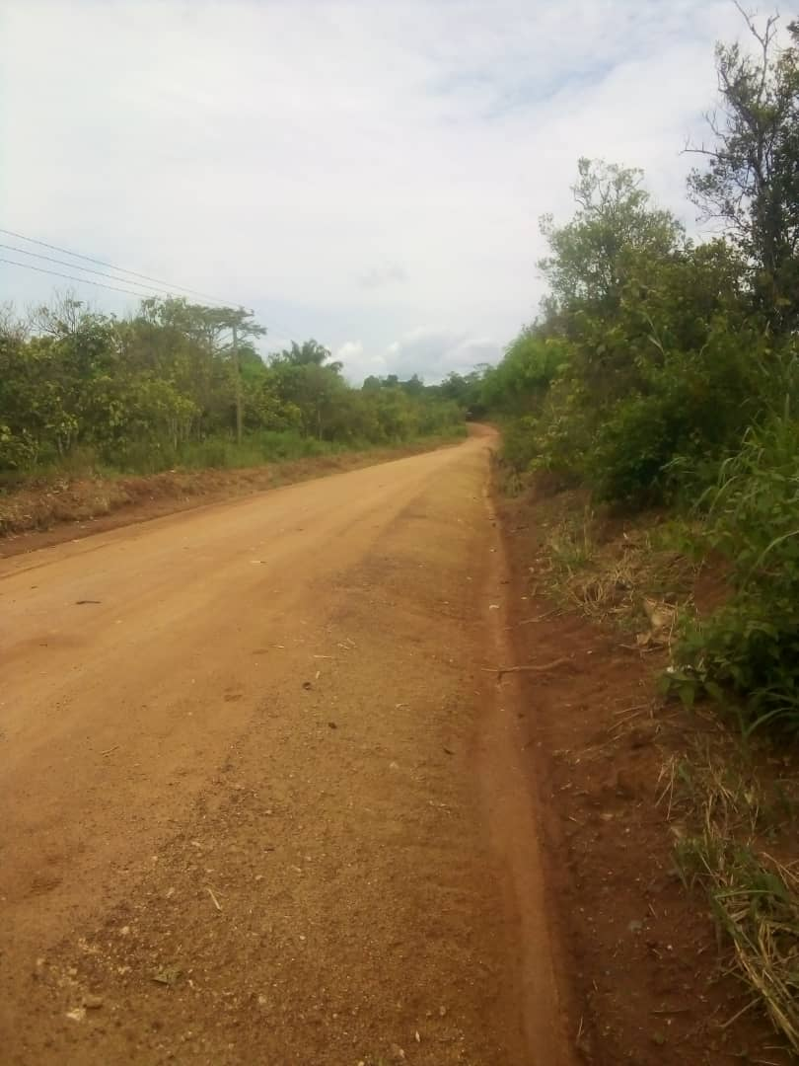
RESHAPED 11KM FEEDER ROAD FROM ATTOHEKROM TO DOMI

Slide 20
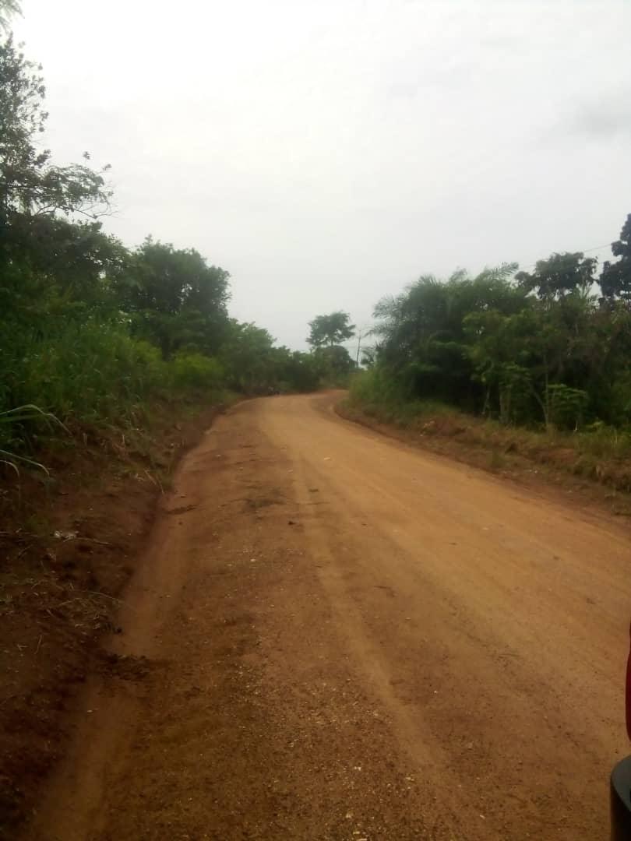
RESHAPED 4KM FEEDER ROAD FROM BOINZAN TO AMANTRESO

Slide 21
Policy Outcome Indicators and Targets
Outcome Indicator | Outcome Indicator Description | Unit of Measurement | Previous year’s performance (2023) |  | Current year’s Actual Performance (2024)
 |  |  | Target | Actual | Target | Actuals as at September
Improvement in performance in Education | Percentage Pass in BECE | Percentage | 95% | 94% | 95% | Awaiting
 | Percentage Pass in WASSCE | Percentage | 100% | 97% | 100% | Awaiting
Improvement in Road Network | No. of Kilometers of roads reshaped | Number. of Kilometers | 135KM | 49.6KM | 135KM | 132.7KM
Improvement in Sanitation Services | Total volume of waste disposed | Metric Tons | 11,000mt | 7,874mt | 11,000mt | 6,055mt
 | Percentage of population with access to proper toilet facilities | Percentage | 62% | 39.7% | 65% | 41.4%
Improvement in Agricultural Productivity | Yield per Hector (maize mt) | Metric Tons per Hectare | 1.9 | 2.12 | 3.0 | 2.45
 | Yield per hectare (rice mt) | Metric Tons per Hectare | 1.92 | 2.02 | 2.5 | 1.73

Slide 22
SANITATION BUDGET PERFORMANCE
LIQUID WASTE
NO. | NAME OF ACTIVITY/PROJECT | BUDGET | ACT. @ SEP 2024
1. | Extension of water to 8-seater WC at District Assembly Office | 35,550.00 | 7,500.00
2. | Fumigation Exercise | 175,000.00 | 100,625.00
SOLID WASTE
1. | Sanitation Improvement Plan (SIP) | 175,000.00 | 106,375.00
2. | Maintenance of Final Disposal Site | 137,668.75 | 57,300.00
3. | Support towards National Sanitation Day | 20,000.00 | 0.00
4. | Purchase of Sanitation Equipment | 40,000.00 | 15,000.00

Slide 23
DP SUPPORTED PEROGAMME (SAFETY NET)
NO. | NAME OF ACTIVITY/PROJECT | BUDGET | ACTUAL AS @ SEP 2024
1. | Purchase of Materials, Equipment and Seedlings | 450,000.00 | 232,755.84
2. | Purchase of Fuel and payment of Allowance for M& E Activities | 200,000.00 | 8,770.00
 | TOTAL | 650,000.00 | 241,525.84

Slide 24
GOVERNMENT FLAGSHIP PROJECTS/PROGRAMMES
NO. | NAME OF ACTIVITY/PROJECT | BUDGET | ACTUAL AS @ SEP 2024
1. | Support the implementation of Planting for Food and Jobs programme | 30,000.00 | 0.00
2. | Support the implementation of Planting for Export and Rural Development (PERD) | 35,500.00 | 0.00

Slide 25
OUTLOOK FOR 2025

Slide 26
JUABOSO ADOPTED POLICY OBJECTIVES FOR 2025
FOCUS AREA | ADOPTED POLICY OBJECTIVES | BUDGET ALLOCATION
LOCAL GOVERNMENCE AND DECENTRALIZATION | Deepen political, financial and administrative decentralization | 2,954,802.51
PUBLIC POLICY MANAGEMENT | Enhance Capacity for policy formulation and Coordination | 2,560,182.21
HEALTH AND HEALTH SERVICE | Ensure accessible, and quality Universal Health Coverage (UHC) for all | 853,234.35
WATER AND SANITATION | Improve access to safe, reliable and sustainable water supply services for all | 1,051,415.02
EDUCATION AND TRAINING | Enhance equitable access to, and participation in quality education at all levels | 3,951,482.65

Slide 27
JUABOSO ADOPTED POLICY OBJECTIVES FOR 2025
FOCUS AREA | ADOPTED POLICY OBJECTIVES | BUDGET ALLOCATION
TRANSPORT INFRASTRUCTURE | Improve efficiency and effectiveness of road Transport infrastructure and Services | 754,918.12
HUMAN SETTLEMENT AND HOUSING | Promote sustainable, spatially integrated, balanced and orderly development of human settlement | 518,203.00
AGRICULTURE AND RURAL DEVELOPMENT | Modernize and enhance Agricultural Production Systems | 945,265.13
PRIVATE SECTOR DEVELOPMENT | Support entrepreneurs and Local Economic Development | 748,329.00
DISASTER MANAGEMENT | Promote Proactive Planning for disaster prevention and mitigation. | 5,000.00
TOTAL |  | 14,342,831.99

Slide 28
Policy Outcome Indicators and Targets
Outcome Indicator | Outcome Indicator Description | Unit of Measurement | Baseline (2023) |  | Current year (2024) |  | Budget year (2025) | Indicative year (2026) | Indicative year (2027) | Indicative year (2028)
 |  |  | Target | Actual | Target | Actual as at September | Target | Target | Target | Target
Improvement in Sanitation Management | Total Volume of waste disposed | Metric Tons | 11,000mt | 7,874mt | 11,000mt | 6,055mt | 11,000mt | 11,000mt | 12,000mt | 12,000mt
 | Percentage of population with access to proper toilet facilities | Percentage | 62% | 39.7% | 65% | 41.4% | 70% | 75% | 75% | 80%
Improvement in road networks | No. of kilometers of road reshaped | Number. of Kilometers | 135km | 49.6KM | 135KM | 132.7KM | 145KM | 150KM | 150KM | 150KM
Improvement in Agricultural Productivity | Yield Per Hector(maize) | Metric Tons per hectare | 1.9 | 2.12 | 3.0 | 2.45 | 3.5 | 3.8 | 4.0 | 4.2
 | Yield per Hector (rice) | Metric Ton per hectare | 1.92 | 2.02 | 2.5 | 1.73 | 2.8 | 3.1 | 3.3 | 3.5
Improvement in performance in Education | Percentage Pass in WASSCE | Percentage | 95% | 99% | 100% | Awaiting | 100% | 100% | 100% | 100%
 | Percentage Pass in BECE | Percentage | 95% | 94% | 95% | Awaiting | 95% | 95% | 95% | 95%

Slide 29
2024-2027 REVENUE PROJECTIONS- IGF ONLY
ITEM | 2024 |  | 2025 | 2026 | 2027 | 2028
 | BUDGET | ACTUAL AS @ SEP | PROJECTION | PROJECTION | PROJECTION | PROJECTION
PROPERTY RATE | 77,000.00 | 38,830.74 | 77,000.00 | 84,700.00 | 90,629.00 | 95,160.45
BASIC RATE | 1,000.00 | - | 1,000.00 | 1,100.00 | 1,177.00 | 1,235.85
FEES | 170,000.00 | 143,872.00 | 200,000.00 | 220,000.00 | 235,400.00 | 247,170.00
FINES | 14,000.00 | 13,189.00 | 18,200.00 | 20,020.00 | 21,421.40 | 22,492.47
LICENCE | 300,000.00 | 252,382.88 | 400,000.00 | 440,000.00 | 470,800.00 | 494,340.00
LAND | 60,000.00 | 31,940.00 | 50,000.00 | 55,000.00 | 58,850.00 | 61,792.50
RENT | 95,000.00 | 56,411.64 | 100,000.00 | 110,000.00 | 105,930.00 | 111,226.50
MISC. | - | -
SUB-TOTAL | 717,000.00 | 536,626.26 | 846,200.00 | 930,820.00 | 995,977.40 | 1,045,776.27
STOOLLANDS | 700,000.00 | 301,837.00 | 350,000.00 | 385,000.00 | 411,950.00 | 432,547.50
TOTAL | 1,417,000.00 | 838,463.26 | 1,196,200.00 | 1,315,820.00 | 1,407,927.40 | 1,478,323.77

Slide 30
2025-2028 REVENUE PROJECTIONS- ALL FUNDING SOURCES
 | 2024 |  | 2025 | 2026 | 2027 | 2028
 | BUDGET | ACTUAL AS @ SEP | PROJECTION | PROJECTION | PROJECTION | PROJECTION
IGF | 1,417,000.00 | 838,463.26 | 1,196,200.00 | 1,315,820.00 | 1,407,927.40 | 1,478,323.77
COMPENSATION | 5,167,968.47 | 3,911,433.00 | 5,753,038.54 | 6,328,342.39 | 6,771,326.36 | 7,109,892.68
G&S TRANSFER | 93,500.00 | - | 93,500.00 | 102,850.00 | 110,049.50 | 115,551.98
DACF | 3,686,609.00 | 552,246.34 | 3,500,000.00 | 3,850,000.00 | 4,119,500.00 | 4,325,475.00
DACF-RFG | 2,902,699.00 | 1,837,631.00 | 2,050,093.45 | 2,255,102.80 | 2,412,959.99 | 2,533,607.99
MP'S CF | 1,210,000.00 | 649,214.41 | 500,000.00 | 550,000.00 | 588,500.00 | 617,925.00
PWD | 200,000.00 | 153,696.70 | 250,000.00 | 275,000.00 | 294,250.00 | 308,962.50
Safety Net | 650,000.00 | - | 200,000.00 | 220,000.00 | 235,400.00 | 247,170.00
Carbon Credit | 200,000.00 | - | 800,000.00 | 880,000.00 | 941,600.00 | 988,680.00
TOTAL | 15,527,776.47 | 7,942,684.71 | 14,342,831.99 | 15,777,115.19 | 16,881,513.25 | 17,725,588.91

Slide 31
EXPENDITURE BY BUDGET PROGRAMME AND ECONOMIC CLASSIFICATION –ALL FUNDING SOURCES
BUDGET PROGRAMME | AMOUNT GH
 | COMPENSATION OF EMPLOYEES | GOODS AND SERVICE | CAPITAL EXPENDITURE | TOTAL
MANAGEMENT AND ADMINISTRATION | 4,439,338.66 | 1,772,842.77 | - | 6,212,181.43
SOCIAL SERVICE DELIVERY | 229,403.46 | 1,306,168.76 | 1,976,006.88 | 3,511,579.10
INFRASTRUCTURE DELIVERY | 578,199.40 | 1,038,000.00 | 905,986.97 | 2,522,186.37
ECONOMIC DEVELOPMENT | 714,714.26 | 1,187,500.00 | 184,670.84 | 2,086,885.09
ENVIRONMENTAL MANAGEMENT | - | 10,000.00 |  | 10,000.00
TOTAL | 5,961,655.78 | 5,314,511.53 | 3,066,664.69 | 14,342,831.99

Slide 32
GOVERNMENT FLAGSHIP PROJECTS/PROGRAMMES FOR 2025
NO. | NAME OF ACTIVITY/PROJECT | BUDGET | FUNDING SOURCE
1. | Support the implementation of Planting for Food and Jobs programme | 30,000.00 | DACF
2. | Support for Planting for Export and Rural Development | 35,500.00 | DACF

Slide 33
KEY PROJECTS FOR 2025 AND THEIR CORRESPONDING COST AND JUSTIFICATION
LIST OF ALL PROJECTS | IGF | DACF | DACF-RFG | MP | STOOLLAN. | TOTAL | JUSTIFICATION
Completion of Nurses Quarters at Bonsu Nkwanta |  |  | 127,635.00 |  |  | 127,635.00 | To provide shelter for staff’s who live far away from the Facility
Completion of CHPS Compound at Kefass |  |  | 153,458.45 |  |  | 153,458.45 | To provide health care for people around the District
Construction of KG Block with toilet,store,office and urinal at Bonsu Nkwanta |  |  | 500,000.00 |  |  | 500,000.00 | To ensure quality teaching and learning
Completion of 1 no. 6 unit Classroom Block with Ancillary facilities at Yawagyiemkrom |  | 70,000.00 |  |  |  | 70,000.00 | To ensure quality teaching and learning
Completion of 1 no. 6 unit Classroom Block with Ancillary facilities at Mafia |  | 12,524.87 |  |  |  | 12,524.87 | To ensure quality teaching and learning
Completion of 1 no. 6 unit Classroom Block with Ancillary facilities at Dominibo |  | 30,000.00 |  |  |  | 30,000.00 | To ensure quality teaching and learning
Construction of 1no. 2unit KG Block with toilet,store,office and urinal at Juaboso |  |  | 492,000.00 |  |  | 492,000.00 | To help provide quality teaching and learning
Renovation works at Juaboso Market | 50,675.41 |  |  |  |  | 50,675.41 | To make the market conducive for traders

Slide 34
SANITATION BUDGET
LIQUID WASTE
1. | Provision for Fumigation/SIP | 350,000.00
SOLID WASTE
1. | Maintenance of Final Disposal Site | 207,668.76
2. | Purchase of Sanitation Equipment | 20,000.00
3 | Support toward National Sanitation Day | 40,000.00

Slide 35
DONOR PARTNER (DP) SUPPORT PROGRAMME(CARBON CREDIT
NO. | NAME OF ACTIVITY/PROJECT | BUDGET
1. | Gazette Bye-Laws for (5) Hotspot Intervention Areas | 50,000.00
2. | Public Education | 386,000.00
3. | Support to DPCU activities | 50,000.00
4. | Capacity Building for Assembly Member on RED+ | 34,000.00
5. | Support women in Agro Chemistry (10 communities) | 100,000.00
6. | Stakeholders Meeting in 5 Hotspot Intervention Areas | 50,000.00
7. | Climate Change mitigation measures (20 Schools) | 100,000.00
8. | Monitoring and evaluation | 30,000.00
 | Total | 800,000.00

Slide 36
DONOR PARTNER (DP) SUPPORT PROGRAMME (SAFETY NET)
NO. | NAME OF ACTIVITY/PROJECT | BUDGET
1. | Purchase of Materials and Equipment | 120,000.00
2. | Purchase of Fuel and payment of Allowance for M& E Activities | 80,000.00
 | TOTAL | 200,000.00

Slide 37
GOG - COMPENSATION
CENTRAL ADMINISTRATION | 62 | 3,687,217.49
REVENUE | 5 | 185,063.64
AGRIC | 11 | 714,714.26
PHYSICAL PLANNING | 2 | 90,547.33
SOCIAL WELFARE AND COMMUNITY DEVELOPMENT | 3 | 229,403.45
WORKS | 7 | 487,652.07
HUMAN RESOURCE | 3 | 213,278.57
STATISTICS | 2 | 145,161.73
SUB - TOTAL | 95 | 5,753,038.54
IGF STAFF SALARIES
ASSEMBLY CASUAL WORKERS | 15 | 95,236.49
GRAND TOTAL | 110 | 5,848,275.03

Slide 38
THANK YOU
© 2018. All rights reserved. No part of this publication may be stored in a retrieval system or transmitted in any or by any means, electronic, mechanical, photocopying, recording or otherwise without the prior written permission of the Ministry of Finance

